Slide 1
Linux应用内存管理与错误诊断
在调试器里看glibc堆和Valgrind
张银奎
《软件调试》和《格蠹汇编》作者

Slide 2


Slide 3






张银奎，Raymond Zhang，格蠹老雷，《软件调试》和《格蠹汇编》作者
http://advdbg.org http://weibo.com/dbgger 格友公众号

Slide 4
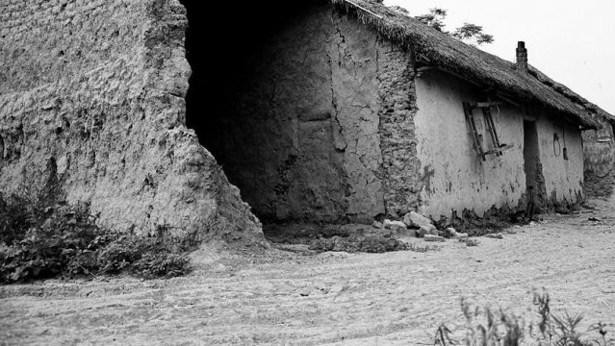
内存问题是软件世界的住房问题

Slide 5



《戊申岁六月中遇火》
陶渊明
草庐寄穷巷，甘以辞华轩。
正夏长风急，林室顿烧燔。一宅无遗宇，舫舟荫门前。迢迢新秋夕，亭亭月将圆。果菜始复生，惊鸟尚未还。中宵伫遥念，一盼周九天。
陶渊明（约365年－427年）
杜甫（712年－770年）
沈从文（1902－1988）
Notes:
茅屋为秋风所破歌_百度汉语
作者：杜甫
八月秋高风怒号，卷我屋上三重茅。茅飞渡江洒江郊，高者挂罥长林梢，下者飘转沉塘坳。 南村群童欺我老无力，忍能对面为盗贼。公然抱茅入竹去，唇焦口燥呼不得，归来倚杖自叹息。 俄顷风定云墨色，秋天漠漠向昏黑。布衾多年冷似铁，娇儿恶卧踏里裂。
床头屋漏无干处，雨脚如麻未断绝。
自经丧乱少睡眠，长夜沾湿何由彻！ 安得广厦千万间，大庇天下寒士俱欢颜！
风雨不动安如山。
呜呼！何时眼前突兀见此屋，吾庐独破受冻死亦足！
挂罥（juàn）：挂着，挂住。罥，挂。长（cháng）：高。
烧燔[shāo fán]
[释义]烧焚；烧毁
公元405年，四十一岁的陶渊明，在江西彭泽县当了八十多天的县令之后，依然无法忍受官场，最终拂袖而去。至此，他一生断断续续但跨度十年的四次仕宦生涯彻底结束。
对于陶渊明归去以后的生活，我们容易从《归去来兮辞》获得一个解脱和闲逸的印象，虽然这篇文章大部分内容不过是作者的文学想象。
实际的情况是，除了写《归去来兮辞》的那一年，陶渊明后来的生活始终与忧患相伴。
比如公元408年的那场大火，就发生在他归去之后的第三年。那年六月中旬的一天，陶渊明在浔阳的旧宅遇火，起火原因不明，但夏天的大风让火势顿时凶猛，家中房屋焚毁殆尽。他只好举家寄居在一条船上。关于火灾事故的相关情况，他在《戊申岁六月中遇火》一诗中说：
“草庐寄穷巷，甘以辞华轩。正夏长风急，林室顿烧燔。一宅无遗宇，舫舟荫门前。迢迢新秋夕，亭亭月将圆。果菜始复生，惊鸟尚未还。中宵伫遥念，一盼周九天。”
安贫乐道的陶渊明本来住在草庐就很安心了，但却天地不仁以万物为刍狗，连这样的草庐也保不住。当时陶渊明已经是五个孩子的父亲，一家七口挤在一条船上是什么样的窘况，我们可以想象。
写这首诗的时候已经是秋天，转凉的天气对陶渊明形成莫大的压力，他甚至彻夜难眠。但想想自己四十多年的人生，虽然许多磨难，所幸内心世界完好无缺。他说：
“总发抱孤介，奄出四十年。形迹凭化往，灵府常独闲。贞刚自有质，玉石乃非坚。”
陶渊明是个非常自省的诗人，他内心没有二元价值论的冲突，因为他早在十九岁那年远游之后，便放弃了在东晋的乱世建功立业的儒家理想。从此，他在精神上成为真正的“五柳先生”，在诗与酒中过一种贫穷但纯净的审美生活。所以即使遭遇火灾的厄运，并且在这难眠的秋夜，他也没有表现出特别的苦闷，而是“穷且益坚”，说自己甘愿追随孤介天性的信念，简直比玉石还要坚固。
虽然如此，但是如果能生在东户时代以及庄子笔下的理想国该多好？那时路不拾遗，田里堆放着余下的粮食，大家鼓腹而遨游，泛若不系之舟。想到这里他仰望天空起了神往，接着吟道：
“仰想东户时，余粮宿中田。鼓腹无所思，朝起暮归眠。”
然而那样的理想国如同天上的星星，闪闪发光却无法抵达。最后他低头一叹：
“既已不遇兹，且遂灌我园。”
一个人无法选择自己所处的时代，更不可能去对抗遇火这样的自然灾害。加上“求仁得仁，又何怨”，所以陶渊明最后还是平静地面对遇火的不幸，并把农人的艰苦生活继续下去。
1969年，“沈从文站在乱糟糟的房间里，他从鼓鼓囊囊的口袋中掏出一封皱巴巴的信，又像哭又像笑地对我说：‘这是她（张兆和，此时已下放湖北咸宁）给我的第一封信。’他把信举起来，面色十分羞涩而温柔……接着就哭起来，快七十岁的老头儿哭得像个小孩子一样又伤心又快乐。”

Slide 6
从万米高空鸟瞰
应用程序
核心思想：
分层管理
批发与零售
隐藏内部细节，用户接口尽可能简单
malloc
kmalloc
堆是针对小额分配而设计的，但是为了编程简单，也支持分配大块
malloc
堆
Driver/module
池
Driver/module
Driver/module
kmalloc
内存管理器

Slide 7
malloc()
The standard C runtime environment lets a user program allocate additional memory
void *malloc( unsigned long nbytes );
This memory is released after being used
void free( void *vaddr );
Using suitable kernel modules we can see how the kernel keeps track of this memory

Slide 8
ptmalloc
基于Doug Lea开发的dlmalloc，主要目的是增加多线程支持
Pt或为POSIX thread之缩写
On Linux systems, ptmalloc has been put to work for years as part of the GNU C library.
迄今为止，共有三个版本
从glibc-2.3.x.开始使用的是ptmalloc2
http://www.malloc.de/en/

Slide 9
版本1的readme文件
ptmalloc - a multi-thread malloc implementation
===============================================
Wolfram Gloger (wg@malloc.de)
19 Dec 1999
Introduction
============
ptmalloc.c is a modified version of Doug Lea's malloc-2.6.4
implementation (available seperately from ftp://g.oswego.edu/pub/misc)
that I adapted for multiple threads, while trying to avoid lock
contention as much as possible. Many thanks should go to Doug Lea
(dl@cs.oswego.edu) for the great original malloc implementation.
As part of the GNU C library, the source files are available under the
GNU Library General Public License (see the comments in the files).
But as part of this stand-alone package, the code is available under
the (probably less restrictive) conditions described in the file
`COPYRIGHT'. In any case, there is no warranty whatsoever for this
package.

Slide 10
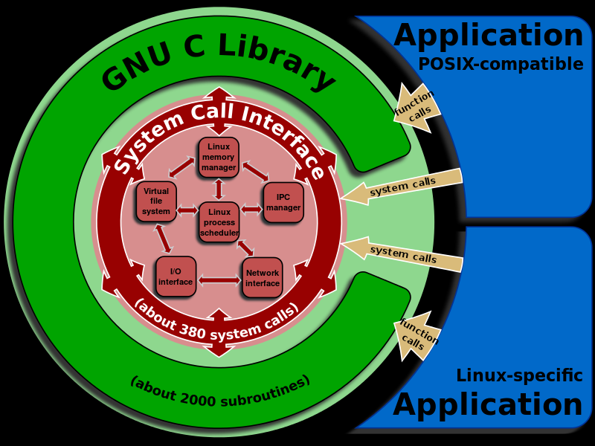
Version 2.3
* Masahide Washizawa contributed iconv modules for IBM1163 and IBM1164
charsets.
* iconv (the program and the interface) now accepts empty names (excluding
options like //TRANSLIT) to mean "use charset of current locale".
* localedef can now transliterate characters in strings which are not in
the provided charmap. The information from the input locale is used.
* Prelinking support was added for ELF targets. This requires additional
tools and recent versions of the GNU binutils. Contributed by Jakub
Jelinek.
* Read-only stdio streams now use mmap to speed up operation by eliminating
copying and buffer underflows. To use add 'm' to the mode string of
the fopen/fdopen/freopen call. Implemented by Ulrich Drepper.
* The malloc functions were completely rewritten by Wolfram Gloger based
on Doug Lea's malloc-2.7.0.c.
* Isamu Hasegawa contributed a completely new and POSIX-conformant
implementation of regex.
* Bruno Haible upgraded the iconv and locale implementation to support
Unicode 3.2.
* Contents of the LC_* and LANG environment variables in the CEN style are
not recognized anymore. It never was used. Change by Ulrich Drepper.
* The runtime (ld.so, libc, libpthread for Linux) now can handle the ELF
thread-local storage (TLS) ABI on some platforms.
Changes by Ulrich Drepper. SH support by Kaz Kojima.
* Bruno Haible contributed iconv converters for ISO-2022-JP-3, SHIFT
JIS-X0213,
EUC-JISX0213, and TISCII.
GNU C library始于1988年，
2.3发布于2002-10-02
https://sourceware.org/glibc/wiki/Glibc%20Timeline

Slide 11
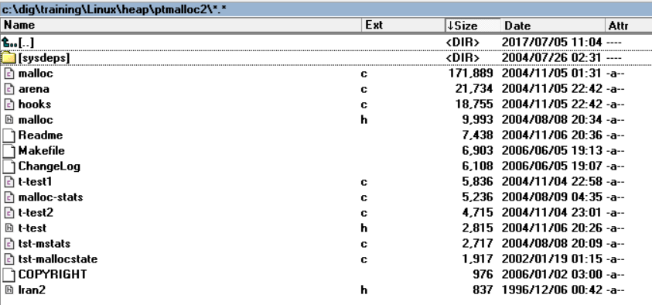
源文件(ptmalloc2)

Slide 12
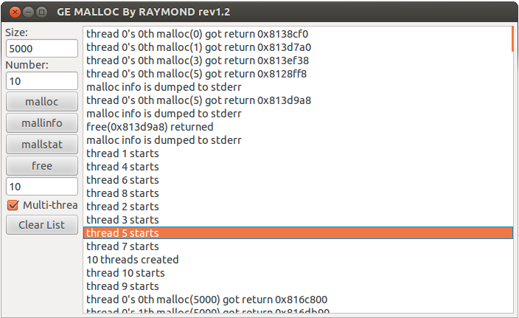

gemalloc
交互式的堆探索辅助工具
支持指定块大小(默认十进制，0x前缀十六进制)和块个数
支持多线程
线程动态创建和退出
Mallinfo
mallstat
Gemalloc

Slide 13
概览
批发
分配和释放
Arena
Valgrind

Slide 14

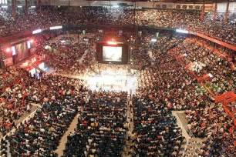

Arena
Notes:
/* An arena is a configuration of malloc_chunks together with an array of bins. With multiple threads, it must be locked via a mutex before changing its data structures. One or more `heaps' are associated with each arena, except for the main_arena, which is associated only with the `main heap', i.e. the conventional free store obtained with calls to MORECORE() (usually sbrk). The `av' array is never mentioned directly in the code, but instead used via bin access macros. */

Slide 15
static struct malloc_state main_arena =
{
.mutex = MUTEX_INITIALIZER,
.next = &main_arena
};
以静态变量形式定义主场地（main arena），与主堆（main heap）关联

Slide 16
(gdb) ptype *av
type = struct malloc_state {
mutex_t mutex;
int flags;
mfastbinptr fastbinsY[10];
mchunkptr top;
mchunkptr last_remainder;
mchunkptr bins[254];
unsigned int binmap[4];
struct malloc_state *next;
struct malloc_state *next_free;
size_t system_mem;
size_t max_system_mem;
}
(gdb) p *av
$2 = {mutex = 1, flags = 0, fastbinsY = {0x0, 0x0, 0x0, 0x0, 0x0, 0x0, 0x0, 0x0, 0x0, 0x0}, top = 0x0,
last_remainder = 0x0, bins = {0x0 <repeats 254 times>}, binmap = {0, 0, 0, 0}, next = 0xb7fc7440, next_free = 0x0,
system_mem = 0, max_system_mem = 0}

Slide 17
(gdb) p &main_arena
$11 = (struct malloc_state *) 0xb7284440
(gdb) p main_arena
$12 = {mutex = 0, flags = 0, fastbinsY = {0x9b9cf18, 0x9ba0c40, 0x9ba1ad8, 0x9b9efd0, 0x9ba0718, 0x9ba4ff8, 0x0, 0x0, 0x0, 0x0},
top = 0x9bb5a68, last_remainder = 0x9b75660, bins = {0x9b75660, 0x9b75660, 0xb7284478, 0xb7284478, 0xb7284480, 0xb7284480,
0xb7284488, 0xb7284488, 0x9b93790, 0x9ab6358, 0xb7284498, 0xb7284498, 0x9ba5198, 0x9b9fd90, 0x9ba33b8, 0x9b988b8, 0x9b76cf8,
0x9ba31f8, 0x9b986b0, 0x9b94ef8, 0xb72844c0, 0xb72844c0, 0x9b9fd20, 0x9b9fd20, 0xb72844d0, 0xb72844d0, 0x9ba4b00, 0x9b936f8,
0xb72844e0, 0xb72844e0, 0x9b9ce78, 0x9b9ce78, 0x9b743f8, 0x9b743f8, 0xb72844f8, 0xb72844f8, 0xb7284500, 0xb7284500,
0xb7284508, 0xb7284508, 0xb7284510, 0xb7284510, 0x9ba50b0, 0x9ba50b0, 0xb7284520, 0xb7284520, 0xb7284528, 0xb7284528,
0xb7284530, 0xb7284530, 0xb7284538, 0xb7284538, 0xb7284540, 0xb7284540, 0xb7284548, 0xb7284548, 0xb7284550, 0xb7284550,
0xb7284558, 0xb7284558, 0xb7284560, 0xb7284560, 0xb7284568, 0xb7284568, 0x9ba05f8, 0x9ba05f8, 0x9b63f60, 0x9b63f60,
0xb7284580, 0xb7284580, 0xb7284588, 0xb7284588, 0xb7284590, 0xb7284590, 0xb7284598, 0xb7284598, 0xb72845a0, 0xb72845a0,
0x9ba4dc0, 0x9ba4dc0, 0xb72845b0, 0xb72845b0, 0xb72845b8, 0xb72845b8, 0xb72845c0, 0xb72845c0, 0xb72845c8, 0xb72845c8,
0x9bb5678, 0x9bb5678, 0xb72845d8, 0xb72845d8, 0xb72845e0, 0xb72845e0, 0x9bb5830, 0x9bb5830, 0x9bb5450, 0x9bb5450, 0xb72845f8,
0xb72845f8, 0xb7284600, 0xb7284600, 0xb7284608, 0xb7284608, 0xb7284610, 0xb7284610, 0xb7284618, 0xb7284618, 0xb7284620,
0xb7284620, 0xb7284628, 0xb7284628, 0xb7284630, 0xb7284630, 0xb7284638, 0xb7284638, 0xb7284640, 0xb7284640, 0xb7284648,
0xb7284648, 0xb7284650, 0xb7284650, 0xb7284658, 0xb7284658, 0xb7284660, 0xb7284660, 0xb7284668, 0xb7284668, 0xb7284670,
0xb7284670, 0xb7284678, 0xb7284678, 0xb7284680, 0xb7284680, 0xb7284688, 0xb7284688, 0xb7284690, 0xb7284690, 0xb7284698,
0xb7284698, 0xb72846a0, 0xb72846a0, 0xb72846a8, 0xb72846a8, 0xb72846b0, 0xb72846b0, 0xb72846b8, 0xb72846b8, 0xb72846c0,
0xb72846c0, 0xb72846c8, 0xb72846c8, 0xb72846d0, 0xb72846d0, 0xb72846d8, 0xb72846d8, 0xb72846e0, 0xb72846e0, 0xb72846e8,
0xb72846e8, 0xb72846f0, 0xb72846f0, 0xb72846f8, 0xb72846f8, 0xb7284700, 0xb7284700, 0xb7284708, 0xb7284708, 0xb7284710,
0xb7284710, 0xb7284718, 0xb7284718, 0xb7284720, 0xb7284720, 0xb7284728, 0xb7284728, 0xb7284730, 0xb7284730, 0xb7284738,
0xb7284738, 0xb7284740, 0xb7284740, 0xb7284748, 0xb7284748, 0xb7284750, 0xb7284750, 0xb7284758, 0xb7284758, 0xb7284760,
0xb7284760, 0xb7284768, 0xb7284768, 0xb7284770, 0xb7284770, 0xb7284778, 0xb7284778, 0xb7284780, 0xb7284780, 0xb7284788,
0xb7284788...}, binmap = {6553572, 205102, 0, 67108864}, next = 0xb5000010, next_free = 0x0, system_mem = 1257472,
max_system_mem = 1433600}
An arena is a configuration of malloc_chunks together with an array of bins.

Slide 18
USE_ARENAS (default: the same as HAVE_MMAP)
Enable support for multiple arenas, allocated using mmap().
HAVE_MMAP (default: defined as 1)
Define to non-zero to optionally make malloc() use mmap() to
allocate very large blocks.
当支持多线程时，总是需要多个Arenas，也就是将USE_ARENAS定义为1
Notes:
Ptmalloc.c

Slide 19
Main Arena
只有一个
Arena管理信息区是静态定义的
可分配区域是传统的堆区域
通过brk机制调整大小
Non-main Arena
0 - 2*(number of cpu cores)
使用mmap机制动态批发
可以有多个子堆
每个子堆一定是连续的

Slide 20
A heap is a single contiguous memory region holding (coalesceable) malloc_chunks.
-- arena.c
这里的堆最好理解为子堆，在ptmalloc里的heap大多时候是这个用法
在ptmalloc中，arena是顶级的实体，一个arena可以有一或者多个（子）堆

Slide 21
_heap_info
/* A heap is a single contiguous memory region holding (coalesceable)
malloc_chunks. It is allocated with mmap() and always starts at an
address aligned to HEAP_MAX_SIZE. */
typedef struct _heap_info {
mstate ar_ptr; /* Arena for this heap. */
struct _heap_info *prev; /* Previous heap. */
size_t size; /* Current size in bytes. */
size_t mprotect_size; /* Size in bytes that has been mprotected
PROT_READ|PROT_WRITE. */
/* Make sure the following data is properly aligned, particularly
that sizeof (heap_info) + 2 * SIZE_SZ is a multiple of
MALLOC_ALIGNMENT. */
char pad[-6 * SIZE_SZ & MALLOC_ALIGN_MASK];
} heap_info;

Slide 22
Main arena布局
通过mmap直接批发的超大块
通过brk机制控制的传统堆
maps中显示为[heap]，可能多行，但是连续
管理信息区
静态变量形式定义
top

Slide 23
Non-main arena布局
运营区
运营区
Arena管理信息区(mstate)
top
heap_info
heap_info
通过mmap直接批发的超大块
prev
第一个子堆
第二个子堆

Slide 24
设计约束带来的好处，可以很简单地计算出（看出）一个来自堆的地址属于哪个子堆和arena
/* find the heap and corresponding arena for a given ptr */
#define heap_for_ptr(ptr) \
((heap_info *)((unsigned long)(ptr) & ~(HEAP_MAX_SIZE-1)))
#define arena_for_chunk(ptr) \
(chunk_non_main_arena(ptr) ? heap_for_ptr(ptr)->ar_ptr : &main_arena)
/* size field is or'ed with NON_MAIN_ARENA if the chunk was obtained
from a non-main arena. This is only set immediately before handing
the chunk to the user, if necessary. */
#define NON_MAIN_ARENA 0x4
/* check for chunk from non-main arena */
#define chunk_non_main_arena(p) ((p)->size & NON_MAIN_ARENA)

Slide 25
#define HEAP_MIN_SIZE (32*1024)
#ifndef HEAP_MAX_SIZE
#define HEAP_MAX_SIZE (1024*1024) /* must be a power of two */
#endif
/* HEAP_MIN_SIZE and HEAP_MAX_SIZE limit the size of mmap()ed heaps
that are dynamically created for multi-threaded programs. The
maximum size must be a power of two, for fast determination of
which heap belongs to a chunk. It should be much larger than the
mmap threshold, so that requests with a size just below that
threshold can be fulfilled without creating too many heaps. */

Slide 26

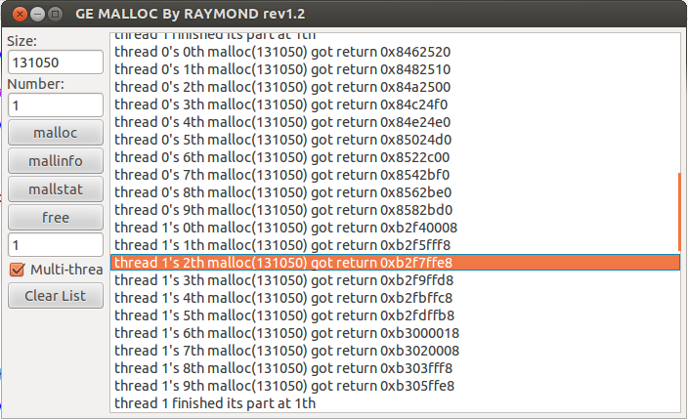
WinDBG: “我有强大的dt命令”
GDB：“我的p加类型强转就可以了”
(gdb) p *(heap_info*)0xb2f00000
$32 = {ar_ptr = 0xb4f00010, prev = 0xb3100000, size = 1048576,
mprotect_size = 1048576, pad = 0xb2f00010 ""}
(gdb) p *((heap_info*)0xb2f00000)->ar_ptr
$38 = {mutex = 0, flags = 2, fastbinsY = {0x0, 0x0, 0x0, 0xb4fe7170,
0xb4f042a8, 0xb4fe71c0, 0x0, 0x0, 0x0, 0x0}, top = 0xb2e3fff0,
last_remainder = 0xb4f02878, bins = {0xb4fe6df8, 0xb4f01ef8, 0xb4f02a58,
0xb4f02f10, 0xb4f02768, 0xb4f043c8, 0xb4f05330, 0xb4f05118, 0xb4f00060,
0xb4f00060, 0xb4f00068, 0xb4f00068, 0xb4f00070, 0xb4f00070, 0xb4f00078,
Notes:
(gdb) p *((heap_info*)0xb2f00000)
$40 = {ar_ptr = 0xb4f00010, prev = 0xb3100000, size = 1048576,
mprotect_size = 1048576, pad = 0xb2f00010 ""}
(gdb) p *((heap_info*)0xb2f00000)->prev
$41 = {ar_ptr = 0xb4f00010, prev = 0xb4f00000, size = 1048576,
mprotect_size = 1048576, pad = 0xb3100010 ""}
(gdb) p *((heap_info*)0xb2f00000)->prev->prev
$42 = {ar_ptr = 0xb4f00010, prev = 0x0, size = 978944, mprotect_size = 978944,
pad = 0xb4f00010 ""}

Slide 27
获取arena和按需创建

Slide 28
public_mALLOc(size_t bytes)
/*------------------------ Public wrappers. --------------------------------*/
Void_t*
public_mALLOc(size_t bytes)
{
mstate ar_ptr;
Void_t *victim;
__malloc_ptr_t (*hook) __MALLOC_P ((size_t, __const __malloc_ptr_t)) =
__malloc_hook;
if (hook != NULL)
return (*hook)(bytes, RETURN_ADDRESS (0));
arena_get(ar_ptr, bytes);
if(!ar_ptr)
return 0;
victim = _int_malloc(ar_ptr, bytes);
内部分配都是围绕arena进行的
来自Gloger网站的代码

Slide 29
/* arena_get() acquires an arena and locks the corresponding mutex.
First, try the one last locked successfully by this thread. (This
is the common case and handled with a macro for speed.) Then, loop
once over the circularly linked list of arenas. If no arena is
readily available, create a new one. In this latter case, `size'
is just a hint as to how much memory will be required immediately
in the new arena. */
#define arena_get(ptr, size) do { \
Void_t *vptr = NULL; \
ptr = (mstate)tsd_getspecific(arena_key, vptr); \
if(ptr && !mutex_trylock(&ptr->mutex)) { \
THREAD_STAT(++(ptr->stat_lock_direct)); \
} else \
ptr = arena_get2(ptr, (size)); \
} while(0)

Slide 30
2906 /*------------------------ Public wrappers. --------------------------------*/
2907
2908 void*
2909 public_mALLOc(size_t bytes)
2910 {
2911 mstate ar_ptr;
2912 void *victim;
2913
2914 __malloc_ptr_t (*hook) (size_t, __const __malloc_ptr_t)
(gdb)
2915 = force_reg (__malloc_hook);
2916 if (__builtin_expect (hook != NULL, 0))
2917 return (*hook)(bytes, RETURN_ADDRESS (0));
2918
2919 arena_lookup(ar_ptr);
2920
2921 arena_lock(ar_ptr, bytes);
2922 if(!ar_ptr)
2923 return 0;
2924 victim = _int_malloc(ar_ptr, bytes);
Glibc中的代码

Slide 31
#define arena_lookup(ptr) do { \
void *vptr = NULL; \
ptr = (mstate)tsd_getspecific(arena_key, vptr); \
} while(0)
做了一些简化，总是从线程局部存储中取，如果取到为空，稍后的lock函数会动态创建

Slide 32
(gdb) disassemble __GI___libc_malloc
Dump of assembler code for function __GI___libc_malloc:
0xb7154ef0 <+0>: sub $0x3c,%esp
0xb7154ef3 <+3>: mov %ebx,0x2c(%esp)
0xb7154ef7 <+7>: call 0xb72096c3 <__i686.get_pc_thunk.bx>
0xb7154efc <+12>: add $0x12f0f8,%ebx
0xb7154f02 <+18>: mov %ebp,0x38(%esp)
0xb7154f06 <+22>: mov 0x40(%esp),%ebp
0xb7154f0a <+26>: mov %esi,0x30(%esp)
0xb7154f0e <+30>: mov %edi,0x34(%esp)
0xb7154f12 <+34>: mov -0xbc(%ebx),%eax
0xb7154f18 <+40>: mov (%eax),%eax
0xb7154f1a <+42>: test %eax,%eax
0xb7154f1c <+44>: jne 0xb71550ba <__GI___libc_malloc+458>
=> 0xb7154f22 <+50>: mov -0x188(%ebx),%edx
0xb7154f28 <+56>: mov %gs:0x0,%ecx
0xb7154f2f <+63>: mov (%ecx,%edx,1),%edi
0xb7154f32 <+66>: test %edi,%edi
0xb7154f34 <+68>: je 0xb7155038 <__GI___libc_malloc+328>

Slide 33
(gdb) set disassembly-flavor intel
(gdb) disassemble __GI___libc_malloc
Dump of assembler code for function __GI___libc_malloc:
0xb7154ef0 <+0>: sub esp,0x3c
0xb7154ef3 <+3>: mov DWORD PTR [esp+0x2c],ebx
0xb7154ef7 <+7>: call 0xb72096c3 <__i686.get_pc_thunk.bx>
0xb7154efc <+12>: add ebx,0x12f0f8
0xb7154f02 <+18>: mov DWORD PTR [esp+0x38],ebp
0xb7154f06 <+22>: mov ebp,DWORD PTR [esp+0x40]
0xb7154f0a <+26>: mov DWORD PTR [esp+0x30],esi
0xb7154f0e <+30>: mov DWORD PTR [esp+0x34],edi
0xb7154f12 <+34>: mov eax,DWORD PTR [ebx-0xbc]
0xb7154f18 <+40>: mov eax,DWORD PTR [eax]
0xb7154f1a <+42>: test eax,eax
0xb7154f1c <+44>: jne 0xb71550ba <__GI___libc_malloc+458>
=> 0xb7154f22 <+50>: mov edx,DWORD PTR [ebx-0x188]
0xb7154f28 <+56>: mov ecx,DWORD PTR gs:0x0
0xb7154f2f <+63>: mov edi,DWORD PTR [ecx+edx*1]
0xb7154f32 <+66>: test edi,edi
0xb7154f34 <+68>: je 0xb7155038 <__GI___libc_malloc+328>

Slide 34
#ifdef PER_THREAD
# define arena_lock(ptr, size) do { \
if(ptr) \
(void)mutex_lock(&ptr->mutex); \
else \
ptr = arena_get2(ptr, (size)); \
} while(0)
#else
# define arena_lock(ptr, size) do { \
if(ptr && !mutex_trylock(&ptr->mutex)) { \
THREAD_STAT(++(ptr->stat_lock_direct)); \
} else \
ptr = arena_get2(ptr, (size)); \
} while(0)
#endif
arena_get2内部如果找不到可用的arena则 _int_new_arena (size);

Slide 35
0xb7154f2f 2919 arena_lookup(ar_ptr);
0xb7154f22 <__GI___libc_malloc+50>: 8b 93 78 fe ff ff mov edx,DWORD PTR [ebx-0x188]
0xb7154f28 <__GI___libc_malloc+56>: 65 8b 0d 00 00 00 00 mov ecx,DWORD PTR gs:0x0
=> 0xb7154f2f <__GI___libc_malloc+63>: 8b 3c 11 mov edi,DWORD PTR [ecx+edx*1]
(gdb) i r
eax 0x0 0
ecx 0xb67f5840 -1233168320
edx 0xffffffd8 -40
ebx 0xb7283ff4 -1222098956
esp 0xbffc2f70 0xbffc2f70
ebp 0x24 0x24
(gdb) x /x $ecx+$edx
0xb67f5818: 0xb7284440
这次分配使用的刚好是主场地
(gdb) p &main_arena
$16 = (struct malloc_state *) 0xb7284440

Slide 36
#0 new_heap (size=3168, top_pad=131072) at arena.c:523
#1 0xb79c227f in _int_new_arena (size=2040) at arena.c:712
#2 arena_get2 (avoid_arena=0x0, size=2040, a_tsd=<optimized out>) at arena.c:856
#3 arena_get2 (a_tsd=<optimized out>, size=2040, avoid_arena=0x0) at arena.c:823
#4 0xb79c422d in __libc_calloc (n=1, elem_size=2040) at malloc.c:3291
#5 0xb7397753 in ?? () from /lib/i386-linux-gnu/libglib-2.0.so.0
#6 0xb7397e6b in g_malloc0 () from /lib/i386-linux-gnu/libglib-2.0.so.0
#7 0xb7360215 in ?? () from /lib/i386-linux-gnu/libglib-2.0.so.0
#8 0xb73ac445 in g_slice_alloc () from /lib/i386-linux-gnu/libglib-2.0.so.0
#9 0xb73ac796 in g_slice_alloc0 () from /lib/i386-linux-gnu/libglib-2.0.so.0
#10 0xb73a004b in g_queue_new () from /lib/i386-linux-gnu/libglib-2.0.so.0
#11 0xb73912d5 in g_main_context_push_thread_default () from /lib/i386-linux-gnu/libglib-2.0.so.0
#12 0xb6e5e11c in ?? () from /usr/lib/i386-linux-gnu/gio/modules/libdconfsettings.so
#13 0xb73b5673 in ?? () from /lib/i386-linux-gnu/libglib-2.0.so.0
#14 0xb7afcd4c in start_thread (arg=0xb6c2fb40) at pthread_create.c:308
#15 0xb7a3b87e in clone () at ../sysdeps/unix/sysv/linux/i386/clone.S:130
(gdb) info threads
Id Target Id Frame
* 2 Thread 0xb6c2fb40 (LWP 13642) "dconf worker" new_heap (size=3168, top_pad=131072) at arena.c:523
1 Thread 0xb7063840 (LWP 13639) "gemalloc" __GI__dl_debug_state () at dl-debug.c:77

Slide 37
(gdb) frame 2
#2 arena_get2 (avoid_arena=0x0, size=2040, a_tsd=<optimized out>) at arena.c:856
856 #else
(gdb) frame 4
#4 0xb79c422d in __libc_calloc (n=1, elem_size=2040) at malloc.c:3291
3291 av = arena_get2(av->next ? av : 0, sz);
if (mem == 0) {
/* Maybe the failure is due to running out of mmapped areas. */
if(av != &main_arena) {
(void)mutex_lock(&main_arena.mutex);
mem = _int_malloc(&main_arena, sz);
(void)mutex_unlock(&main_arena.mutex);
} else {
/* ... or sbrk() has failed and there is still a chance to mmap() */
(void)mutex_lock(&main_arena.mutex);
av = arena_get2(av->next ? av : 0, sz);
(void)mutex_unlock(&main_arena.mutex);
if(av) {
mem = _int_malloc(av, sz);
(void)mutex_unlock(&av->mutex);
}
}
if (mem == 0) return 0;
Calloc的错误处理代码中触发创建

Slide 38
不忘初心
/* Malloc implementation for multiple threads without lock contention.
Copyright (C) 2001-2006, 2007, 2008, 2009, 2011 Free Software Foundation, Inc.
This file is part of the GNU C Library.
Contributed by Wolfram Gloger <wg@malloc.de>, 2001.

Slide 39

* Why use this malloc?
This is not the fastest, most space-conserving, most portable, or most tunable malloc ever written. However it is among the fastest while also being among the most space-conserving, portable and tunable.
Consistent balance across these factors results in a good general-purpose
allocator for malloc-intensive programs.
Malloc.c

Slide 40
创建过程
new_heap
开辟和初始化arena结构体
初始化top块
malloc_chunk
Arena管理信息区(mstate)
top
heap_info

Slide 41
源代码
mstate
_int_new_arena(size_t size)
{
mstate a;
heap_info *h;
char *ptr;
unsigned long misalign;
h = new_heap(size + (sizeof(*h) + sizeof(*a) + MALLOC_ALIGNMENT),
mp_.top_pad);
if(!h) {
/* Maybe size is too large to fit in a single heap. So, just try
to create a minimally-sized arena and let _int_malloc() attempt
to deal with the large request via mmap_chunk(). */
h = new_heap(sizeof(*h) + sizeof(*a) + MALLOC_ALIGNMENT, mp_.top_pad);
if(!h)
return 0;
}

Slide 42
a = h->ar_ptr = (mstate)(h+1);
malloc_init_state(a);
/*a->next = NULL;*/
a->system_mem = a->max_system_mem = h->size;
arena_mem += h->size;
#ifdef NO_THREADS
if((unsigned long)(mp_.mmapped_mem + arena_mem + main_arena.system_mem) >
mp_.max_total_mem)
mp_.max_total_mem = mp_.mmapped_mem + arena_mem + main_arena.system_mem;
#endif
/* Set up the top chunk, with proper alignment. */
ptr = (char *)(a + 1);
misalign = (unsigned long)chunk2mem(ptr) & MALLOC_ALIGN_MASK;
if (misalign > 0)
ptr += MALLOC_ALIGNMENT - misalign;
top(a) = (mchunkptr)ptr;
set_head(top(a), (((char*)h + h->size) - ptr) | PREV_INUSE);
return a;
}

Slide 43
Arena小结
Main_Arena是静态定义的
根据需要动态创建更多的Arena
直到找到一个可用的
最多每个线程一个，但可以通过配置参数设置上限
单CPU系统，常常有三个
增加CPU个数后（并发度增大），多线程的gemalloc小程序创建10个工作线程后，有6个Arena

Slide 44

他山之石，可以为错
Windows | Linux/Glibc
堆（Heap） | Arena
段（Segment） | Heap（子堆）
Entry | Chunk

Slide 45
概览
批发
分配和释放
Arena
Valgrind

Slide 46
/*
sysmalloc handles malloc cases requiring more memory from the system.
On entry, it is assumed that av->top does not have enough
space to service request for nb bytes, thus requiring that av->top
be extended or replaced.
*/

Slide 47
三大块代码
SYSMALLOC
分配超大块
扩展或者更换top块
主场地
非主场地
Grow_heap
New_heap
brk
mmap
mmap

Slide 48
主arena被触发扩容
(gdb) bt
#0 __brk (addr=0x0) at ../sysdeps/unix/sysv/linux/i386/brk.c:52
#1 0xb7a33571 in __GI___sbrk (increment=135168) at sbrk.c:44
#2 0xb79c4f4f in __GI___default_morecore (increment=135168) at morecore.c:49
#3 0xb79c0e82 in sYSMALLOc (av=0xffffefd0, nb=360) at malloc.c:2535
#4 _int_malloc (av=0xffffefd0, bytes=352) at malloc.c:3932
#5 0xb79c2f5c in __GI___libc_malloc (bytes=352) at malloc.c:2924
#6 0xb79c30c7 in __GI___libc_malloc (bytes=352) at malloc.c:2917
#7 0xb79aee08 in __fopen_internal (filename=0xb710ef86 "/proc/filesystems", mode=0xb710ee7b "r", is32=0) at iofopen.c:76
#8 0xb79b163b in _IO_fopen64 (filename=0xb710ef86 "/proc/filesystems", mode=0xb710ee7b "r") at iofopen64.c:39
#9 0xb70fd2d3 in ?? () from /lib/i386-linux-gnu/libselinux.so.1
#10 0xb7fece5b in call_init (env=0xbffff41c, argv=0xbffff414, argc=1, l=<optimized out>) at dl-init.c:85
#11 call_init (l=<optimized out>, argc=1, argv=0xbffff414, env=0xbffff41c) at dl-init.c:35
#12 0xb7fecf44 in _dl_init (main_map=<optimized out>, argc=1, argv=0xbffff414, env=0xbffff41c) at dl-init.c:134
#13 0xb7fdf20f in _dl_start_user () from /lib/ld-linux.so.2

Slide 49
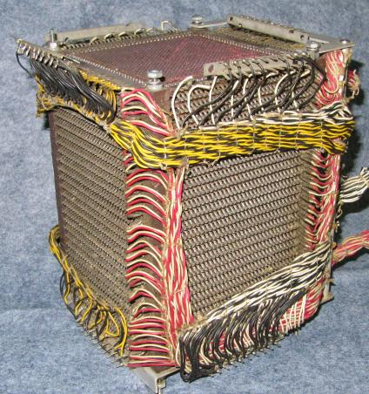
/*
MORECORE is the name of the routine to call to obtain more memory
from the system. See below for general guidance on writing
alternative MORECORE functions, as well as a version for WIN32 and a
sample version for pre-OSX macos.
*/
#ifndef MORECORE
#define MORECORE sbrk
#endif

Slide 50
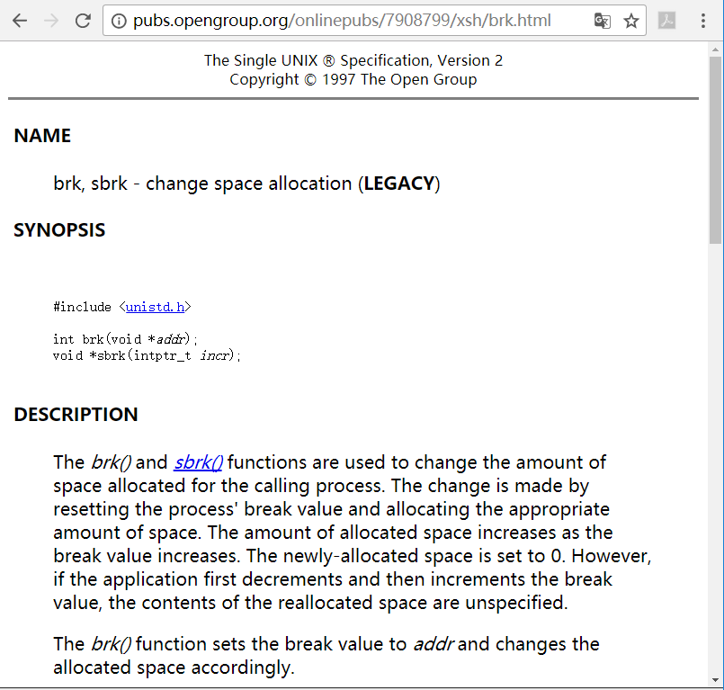
brk
#include <unistd.h>
int brk(void *addr);
void *sbrk(intptr_t increment);
change data segment size
Notes:
brk and sbrk are basic memory management system calls used in Unix and Unix-like operating systems to control the amount of memory allocated to the data segment of the process.^{[1]} These functions are typically called from a higher-level memory management library function such as malloc. In the original Unix system, brk and sbrk were the only ways in which applications could acquire additional data space; later versions allowed this to also be done using the mmap call.^{[citation needed]}
The brk and sbrk calls dynamically change the amount of space allocated for the data segment of the calling process. The change is made by resetting the program break of the process, which determines the maximum space that can be allocated. The program break is the address of the first location beyond the current end of the data region. The amount of available space increases as the break value increases. The available space is initialized to a value of zero.^{[2]} The break value can be automatically rounded up to a size appropriate for the memory managementarchitecture.

Slide 51
更替top块
Hardware watchpoint 9: main_arena->top
Old value = (mchunkptr) 0xb7af2470
New value = (mchunkptr) 0x804c000
Hardware watchpoint 10: main_arena->top
Old value = (mchunkptr) 0xb7af2470
New value = (mchunkptr) 0x804c000
sYSMALLOc (av=0xffffefd0, nb=360) at malloc.c:2697
2697 set_head(av->top, (snd_brk - aligned_brk + correction) | PREV_INUSE);

Slide 52
ge@gewubox:~$ cat /proc/2748/maps | grep "\[heap\]"
0804c000-0806d000 rw-p 00000000 00:00 0 [heap]
Notes:
ge@gewubox:~$ cat /proc/2748/maps | grep "\[heap\]"
0804c000-0806d000 rw-p 00000000 00:00 0 [heap]

Slide 53
#0 __GI___sbrk (increment=143360) at sbrk.c:55
#1 0xb79c4f4f in __GI___default_morecore (increment=143360) at morecore.c:49
#2 0xb79c0e82 in sYSMALLOc (av=0xffffefd0, nb=32800) at malloc.c:2535
#3 _int_malloc (av=0xffffefd0, bytes=32796) at malloc.c:3932
#4 0xb79c2f5c in __GI___libc_malloc (bytes=32796) at malloc.c:2924
#5 0xb79fffc8 in __alloc_dir (fd=8, close_fd=<optimized out>, flags=<optimized out>, statp=0x0) at ../sysdeps/unix/opendir.c:202
#6 0xb7a000f7 in __opendirat (dfd=<optimized out>, name=<optimized out>) at ../sysdeps/unix/opendir.c:148
#7 0xb7a0013d in __opendir (name=0xb75eed88 "/usr/lib/i386-linux-gnu/gio/modules") at ../sysdeps/unix/opendir.c:156
#8 0xb737d0dc in g_dir_open () from /lib/i386-linux-gnu/libglib-2.0.so.0
……
#18 0xb6e1bc00 in os_utils_is_blacklisted () from /usr/lib/liboverlay-scrollbar-0.2.so.0
#19 0xb7c962cc in ?? () from /usr/lib/i386-linux-gnu/libgtk-x11-2.0.so.0
#20 0xb739db12 in g_option_context_parse () from /lib/i386-linux-gnu/libglib-2.0.so.0
#21 0xb7c96988 in gtk_parse_args () from /usr/lib/i386-linux-gnu/libgtk-x11-2.0.so.0
#22 0xb7c96a13 in gtk_init_check () from /usr/lib/i386-linux-gnu/libgtk-x11-2.0.so.0
#23 0xb7c96a53 in gtk_init () from /usr/lib/i386-linux-gnu/libgtk-x11-2.0.so.0
#24 0x08049332 in main (argc=1, argv=0xbffff414) at gemalloc.c:145

Slide 54
0xb7af2780, 0xb7af2780, 0xb7af2788, 0xb7af2788...}, binmap = {20, 33554432, 16, 0}, next = 0xb7af2440, next_free = 0x0, system_mem = 135168, max_system_mem = 135168}
(gdb) watch main_arena->system_mem
Hardware watchpoint 15: main_arena->system_mem
(gdb) c
Continuing.
Hardware watchpoint 15: main_arena->system_mem
Old value = 135168
New value = 278528
sYSMALLOc (av=0xffffefd0, nb=32800) at malloc.c:2591
2591 if (brk == old_end && snd_brk == (char*)(MORECORE_FAILURE))
(gdb) p 135168+143360
$30 = 278528
#0 sYSMALLOc (av=0xffffefd0, nb=32800) at malloc.c:2591
#1 _int_malloc (av=0xffffefd0, bytes=32796) at malloc.c:3932
#2 0xb79c2f5c in __GI___libc_malloc (bytes=32796) at malloc.c:2924
Notes:
更新main_arena->system_mem

Slide 55
ge@gewubox:~/eglibc-2.15$ cat /proc/13795/maps | grep "heap"
08048000-0804a000 r-xp 00000000 08:01 1835228 /home/ge/work/geheap/gemalloc
0804a000-0804b000 r--p 00001000 08:01 1835228 /home/ge/work/geheap/gemalloc
0804b000-0804c000 rw-p 00002000 08:01 1835228 /home/ge/work/geheap/gemalloc
0804c000-0806d000 rw-p 00000000 00:00 0 [heap]
0806d000-08090000 rw-p 00000000 00:00 0 [heap]
所以，maps文件看到的heap块数与arena个数不是一会事，可能不一致

Slide 56
辅Arena用mmap从内核批发内存
mmap and associated systems calls were designed as part of the Berkeley Software Distribution (BSD) version of Unix. Their API was already described in the 4.2BSD System Manual, even though it was neither implemented in that release, nor in 4.3BSD.[1] Sun Microsystems had implemented this very API, though, in their SunOS operating system. The BSD developers at U.C. Berkeley requested Sun to donate its implementation, but these talks never led to any transfer of code; 4.3BSD-Reno was shipped instead with an implementation based on the virtual memory system of Mach.[2] -- wikipedia
#include <sys/mman.h>
void *mmap(void *addr, size_t length, int prot, int flags,
int fd, off_t offset);
int munmap(void *addr, size_t length);
历史上，比brk机制要出现的晚

Slide 57
创建第一个子堆
#0 mmap () at ../sysdeps/unix/sysv/linux/i386/mmap.S:98
#1 0xb79be6c7 in new_heap (size=<optimized out>, top_pad=<optimized out>) at arena.c:554
#2 0xb79c227f in _int_new_arena (size=2040) at arena.c:712
#3 arena_get2 (avoid_arena=0x0, size=2040, a_tsd=<optimized out>) at arena.c:856
#4 arena_get2 (a_tsd=<optimized out>, size=2040, avoid_arena=0x0) at arena.c:823
#5 0xb79c422d in __libc_calloc (n=1, elem_size=2040) at malloc.c:3291

Slide 58
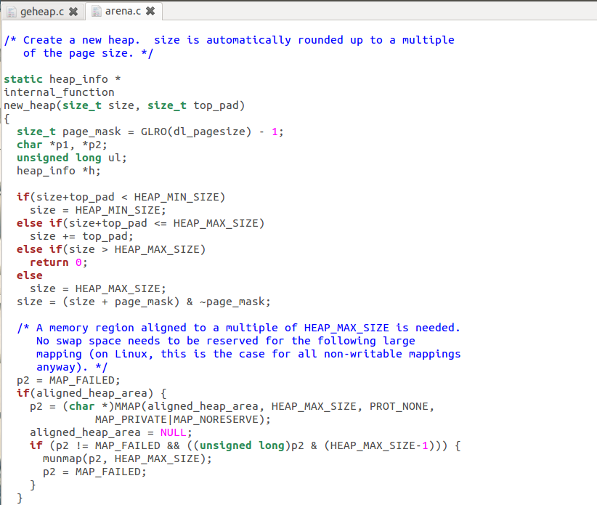

Slide 59
创建第二个
New_heap()函数返回后，观察
(gdb) p *heap
$27 = {ar_ptr = 0xb4f00010, prev = 0xb4f00000, size = 266240,
mprotect_size = 266240, pad = 0xb3100010 ""}
(gdb) bt
#0 sYSMALLOc (av=0xb4f00010, nb=131064) at malloc.c:2476
#1 _int_malloc (av=0xb4f00010, bytes=131060) at malloc.c:3932
#2 0xb7818f5c in __GI___libc_malloc (bytes=131060) at malloc.c:2924
#3 0x080492e4 in do_malloc (nsize=131060, no=10, threadno=1) at gemalloc.c:49
#4 0x0804947c in thread_func (arg=0x1) at gemalloc.c:111
#5 0xb7952d4c in start_thread (arg=0xb5810b40) at pthread_create.c:308
#6 0xb789187e in clone () at ../sysdeps/unix/sysv/linux/i386/clone.S:130
创建新的heap，此后，一个场地具有多个heap

Slide 60
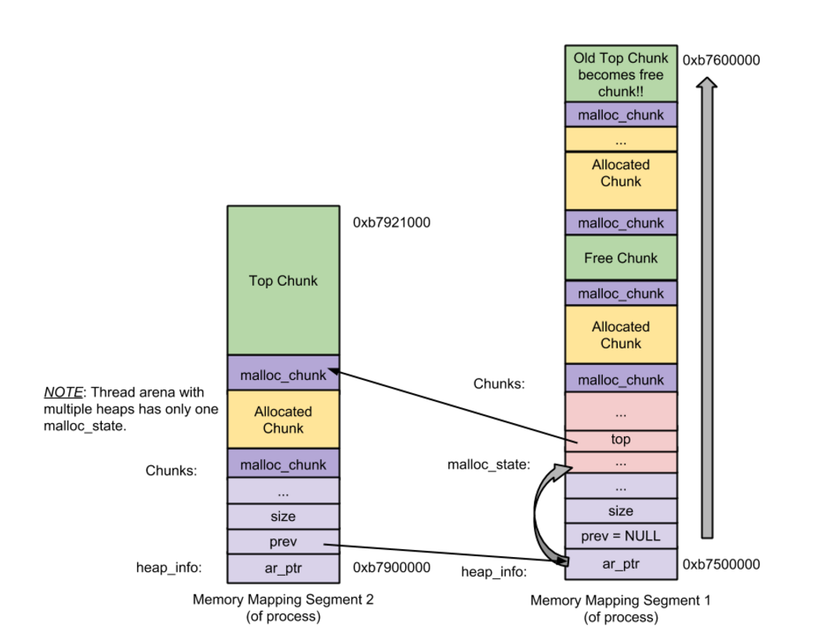
一个arena的两个子堆
老的top块变成空闲块
新分配出的运营区划出一块给当前的请求，余下的成为新的top块
两个子堆共用一个mstate结构体

Slide 61
后两个子堆的大小都为1MB，第一个略小，arena结构体有1104字节
(gdb) p *((heap_info*)0xb2f00000)
$40 = {ar_ptr = 0xb4f00010, prev = 0xb3100000, size = 1048576,
mprotect_size = 1048576, pad = 0xb2f00010 ""}
(gdb) p *((heap_info*)0xb2f00000)->prev
$41 = {ar_ptr = 0xb4f00010, prev = 0xb4f00000, size = 1048576,
mprotect_size = 1048576, pad = 0xb3100010 ""}
(gdb) p *((heap_info*)0xb2f00000)->prev->prev
$42 = {ar_ptr = 0xb4f00010, prev = 0x0, size = 978944, mprotect_size = 978944,
pad = 0xb4f00010 ""}

Slide 62
分配超大块
/*
If have mmap, and the request size meets the mmap threshold, and
the system supports mmap, and there are few enough currently
allocated mmapped regions, try to directly map this request
rather than expanding top.
*/
if ((unsigned long)(nb) >= (unsigned long)(mp_.mmap_threshold) &&
(mp_.n_mmaps < mp_.n_mmaps_max)) {

Slide 63
分配超大块(>=128KB)
#0 mmap () at ../sysdeps/unix/sysv/linux/i386/mmap.S:35
#1 0xb7817328 in sYSMALLOc (av=0xb4f00010, nb=131080) at malloc.c:2400
#2 _int_malloc (av=0xb4f00010, bytes=131072) at malloc.c:3932
#3 0xb7818f5c in __GI___libc_malloc (bytes=131072) at malloc.c:2924
#4 0x080492e4 in do_malloc (nsize=131072, no=1, threadno=1) at gemalloc.c:49
#5 0x0804947c in thread_func (arg=0x1) at gemalloc.c:111
#6 0xb7952d4c in start_thread (arg=0xb5810b40) at pthread_create.c:308
#7 0xb789187e in clone () at ../sysdeps/unix/sysv/linux/i386/clone.S:130

Slide 64
08685000-086a5000 rw-p 00000000 00:00 0 [heap]
086a5000-086c5000 rw-p 00000000 00:00 0 [heap]
086c5000-086e5000 rw-p 00000000 00:00 0 [heap]
086e5000-08705000 rw-p 00000000 00:00 0 [heap]
08705000-08725000 rw-p 00000000 00:00 0 [heap]
08725000-08745000 rw-p 00000000 00:00 0 [heap]
08745000-08785000 rw-p 00000000 00:00 0 [heap]
08785000-0879b000 rw-p 00000000 00:00 0 [heap]
0879b000-087db000 rw-p 00000000 00:00 0 [heap]
087db000-0881b000 rw-p 00000000 00:00 0 [heap]
0881b000-0885b000 rw-p 00000000 00:00 0 [heap]
0885b000-0889b000 rw-p 00000000 00:00 0 [heap]
0889b000-088db000 rw-p 00000000 00:00 0 [heap]
088db000-0891b000 rw-p 00000000 00:00 0 [heap]
0891b000-0895b000 rw-p 00000000 00:00 0 [heap]
0895b000-0899b000 rw-p 00000000 00:00 0 [heap]
0899b000-089db000 rw-p 00000000 00:00 0 [heap]
089db000-08a1b000 rw-p 00000000 00:00 0 [heap]
b2b00000-b2c41000 rw-p 00000000 00:00 0
b2c41000-b2d00000 ---p 00000000 00:00 0
b2d00000-b2f00000 rw-p 00000000 00:00 0
b2f00000-b3100000 rw-p 00000000 00:00 0
b3100000-b3200000 rw-p 00000000 00:00 0
b32f8000-b3319000 rw-p 00000000 00:00 0
b3319000-b333a000 rw-p 00000000 00:00 0
b333a000-b3fbb000 rw-p 00000000 00:00 0
b3fbb000-b4c3c000 rw-p 00000000 00:00 0
b4c3c000-b4d7d000 rw-p 00000000 00:00 0
b4d7d000-b4ebe000 rw-p 00000000 00:00 0
b4ebe000-b4edf000 rw-p 00000000 00:00 0
b4edf000-b4f00000 rw-p 00000000 00:00 0
b4f00000-b4fef000 rw-p 00000000 00:00 0
b4fef000-b5000000 ---p 00000000 00:00 0
b5010000-b5011000 ---p 00000000 00:00 0
主arena的运营区向高地发展
辅arena的运营区和超大块从高地址到低地址方向发展

Slide 65
概览
批发
分配和释放
Arena
Valgrind

Slide 66
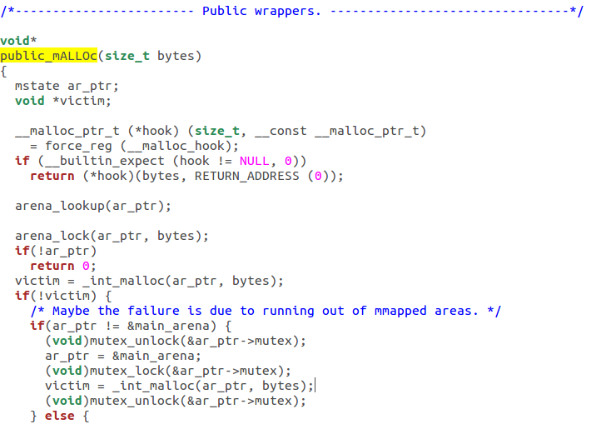
从外部接口到内部实现
#0 _int_malloc (av=0xb7fc7440, bytes=10) at malloc.c:3485
#1 0xb7e97f5c in __GI___libc_malloc (bytes=10) at malloc.c:2924
#2 0xb7e980c7 in __GI___libc_malloc (bytes=10) at malloc.c:2917
#3 0x08048401 in main (argc=1, argv=0xbffff414) at geheap.c:9

Slide 67
内部分配函数
/*
------------------------------ malloc ------------------------------
*/
Void_t*
_int_malloc(mstate av, size_t bytes)
{
INTERNAL_SIZE_T nb; /* normalized request size */
unsigned int idx; /* associated bin index */
mbinptr bin; /* associated bin */
mfastbinptr* fb; /* associated fastbin */
mchunkptr victim; /* inspected/selected chunk */
INTERNAL_SIZE_T size; /* its size */
int victim_index; /* its bin index */
mchunkptr remainder; /* remainder from a split */
unsigned long remainder_size; /* its size */
unsigned int block; /* bit map traverser */
unsigned int bit; /* bit map traverser */
unsigned int map; /* current word of binmap */
mchunkptr fwd; /* misc temp for linking */
mchunkptr bck; /* misc temp for linking */

Slide 68
malloc_chunk
/*
This struct declaration is misleading (but accurate and necessary).
It declares a "view" into memory allowing access to necessary
fields at known offsets from a given base. See explanation below.
*/
struct malloc_chunk {
INTERNAL_SIZE_T prev_size; /* Size of previous chunk (if free). */
INTERNAL_SIZE_T size; /* Size in bytes, including overhead. */
struct malloc_chunk* fd; /* double links -- used only if free. */
struct malloc_chunk* bk;
/* Only used for large blocks: pointer to next larger size. */
struct malloc_chunk* fd_nextsize; /* double links -- used only if free. */
struct malloc_chunk* bk_nextsize;
};

Slide 69
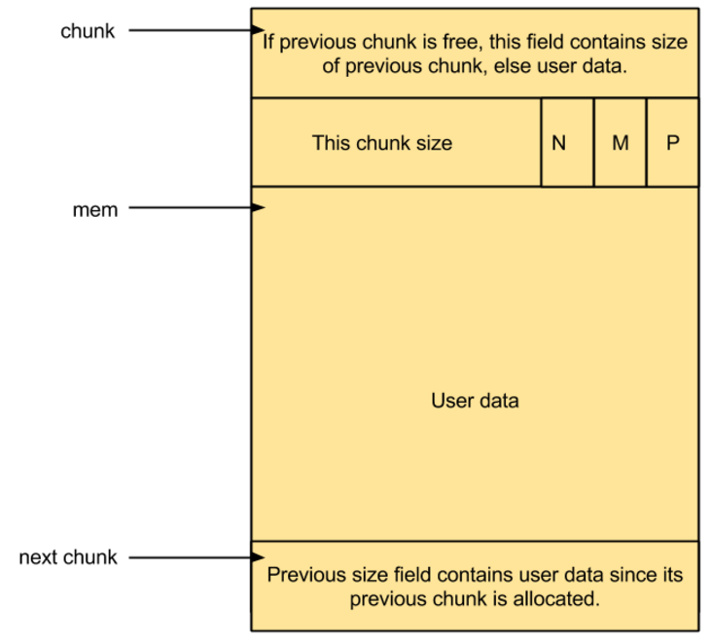
Allocated chunk
prev_size: If the previous chunk is free, this field contains the size of previous chunk. Else if previous chunk is allocated, this field contains previous chunk’s user data.
size: This field contains the size of this allocated chunk. Last 3 bits of this field contains flag information.
PREV_INUSE (P) – This bit is set when previous chunk is allocated.
IS_MMAPPED (M) – This bit is set when chunk is mmap’d.
NON_MAIN_ARENA (N) – This bit is set when this chunk belongs to a thread arena.
Notes:
\
p/}}

Slide 70
三个标志位
/* size field is or'ed with PREV_INUSE when previous adjacent chunk in use */
#define PREV_INUSE 0x1
/* extract inuse bit of previous chunk */
#define prev_inuse(p) ((p)->size & PREV_INUSE)
/* size field is or'ed with IS_MMAPPED if the chunk was obtained with mmap() */
#define IS_MMAPPED 0x2
/* check for mmap()'ed chunk */
#define chunk_is_mmapped(p) ((p)->size & IS_MMAPPED)
/* size field is or'ed with NON_MAIN_ARENA if the chunk was obtained
from a non-main arena. This is only set immediately before handing
the chunk to the user, if necessary. */
#define NON_MAIN_ARENA 0x4
/* check for chunk from non-main arena */
#define chunk_non_main_arena(p) ((p)->size & NON_MAIN_ARENA)

Slide 71
看人下菜碟儿
小块
大块
超大块
64B
The main properties of the algorithms are:
* For large (>= 512 bytes) requests, it is a pure best-fit allocator,
with ties normally decided via FIFO (i.e. least recently used).
* For small (<= 64 bytes by default) requests, it is a caching
allocator, that maintains pools of quickly recycled chunks.
* In between, and for combinations of large and small requests, it does
the best it can trying to meet both goals at once.
* For very large requests (>= 128KB by default), it relies on system
memory mapping facilities, if supported.
-- malloc.c
512B
128KB
赵姨娘也不答话，走上来便将粉照着芳官脸上撒来，指着芳官骂道：“我家里下三等奴才也比你高贵些的，你都会看人下菜碟儿。宝玉要给东西，你拦在头里，莫不是要了你的了？拿这个哄他，你只当他不认得呢！”
--清·曹雪芹《红楼梦》第六十回 茉莉粉替去蔷薇硝 玫瑰露引来茯苓霜
Notes:
赵姨娘，古典小说《红楼梦》中的角色。她是荣国府二老爷贾政之妾，环三爷贾环和三姑娘贾探春之生母。赵姨娘是家生女儿出生，所谓家生女儿，就是小厮与放出去的丫鬟结合生下的下一代。
也许，赵姨娘年轻时候是漂亮的，看探春的容貌大概可以略知一二。于是，赵姨娘成了贾政的妾，这是她幸运的一步，却也是不幸的开始。
出处《红楼梦》“看人下菜碟”可分为两个方面，一个是“看人”、一个是“下菜碟”。“
看人下菜碟
话出赵姨娘之口。
《红楼梦》第六十回中，芳官得了蕊官送的蔷薇硝喜滋滋向宝玉炫耀。不料，那贾环见了竟张口索要。这是情人送的爱物，芳官当然不愿意送给贾环，便找原先那包。岂知翻来
寻去找不到，一旁里麝月说：你不管拿些什么给他们，哪里看得出来，快打发他们去了。芳官听了，便用茉莉粉打发了贾环。不料这一打发，打发出了个闹剧。
赵姨娘见了茉莉粉，知道是糊弄贾环，顿时火起，怒冲冲找到怡红院，将那粉照着芳官的脸上摔去，手指着鼻尖骂道：小娼妇养的！你是我们家银子买来学戏的，不过娼妇粉头之流，我家里下三等奴才也比你高贵些，你都会看人下菜碟。
得，看人下菜碟出来了，芳官的举止不知不觉轻慢了贾环，也等于轻慢了赵姨娘。赵姨娘常被人轻慢，窝着一肚子火没地方发，正碰上个不识时务的小戏子犯上作乱，岂不冒火？你不是王夫人，你不是王熙凤，也不是老太太的心肝宝玉，老娘为何要受你的气？于是，扑过来摔过去，闹打开了。其实，赵姨娘这举动也是看人下菜碟，换个有脸的人，她敢？
细想一下，其实这世上哪一位不是看人下菜碟？一切的规矩礼法，似乎都起始于看人下菜碟。看准了人，下对了菜，就是正常礼仪，摆在桌面上便是合乎接待规范。所以，赵姨娘口中的看人下菜碟和现世流行的看人下菜碟都是一回事，是指本意之外的一切人际关系。不过若要理解意外之意，尚需好好体会一下意中之意。
我这人在城里住了三十余年了，可是我觉得自己仍然是个农民。大鱼大肉不喜欢，而见了菜窝窝倒是谢天谢地！反之，即使饭菜再丰盛，我也不喜欢。为啥？还是招待者不懂看人下菜碟！但是，切记也不要一把尺子量到底。招待他人，得按他人的胃口下菜。我主管过接待，不同人有不同标准。政务人员曾严格要求过四菜一汤。哪怕端上来就吃光也不能超越。而对外商就另当别论了，丰盛的饭菜几乎没动筷子，就撤了下去。因而有人怨怪，不过怨怪归怨怪，廉政防线不能逾越。
仅仅怨怪还算罢了，关键是芝麻小的问题竟成了西瓜大的错误，甚而弄得难以正常工作。这就不得不思考了，思来想去，问题出在四菜一汤上，连忙拓展思路，四菜仍是四菜，只是一个大菜盘里少不了要装小四菜，一汤还是一汤，只是舀了10碗还可以再舀。这么一来，酒桌皆大欢喜，工作皆大欢喜，即使西瓜大的错误也变成芝麻小的问题。芝麻小的问题还算问题吗？不算，也就没了问题。
这都是先前的事了。后来层次分明了，麻烦更少了，有人划拉了这么几个台面：喝白酒，打白条；喝啤酒，说屁话；喝红酒，收红包；喝洋酒，泡洋妞。一个台面，一个标准，差别十分明显。幸亏赵姨娘早不在这世上了，若要在，不气破肚子才怪。你见人家宝玉喝洋酒，泡洋妞，也想让你那贾环过过瘾，没门，你就安心让娃喝白酒，打白条吧！这世上喝不起白酒的人有的是，只能手握着人家打的白条干瞪眼。这就是人常说的，前头有个骑驴的，后头有个不如的。
如此想来，赵姨娘开心了吧，千万莫骂看人下菜碟了，再骂只能丢了自家的身份。世上原来就这么个道理，就这么个秩序，古今一样，中外一理。至于下个世纪怎么样？那不是我这草木之人说得清的了。

Slide 72

图书馆目录的怀旧情结
在有目录的时代，读者见到的都是读者目录，放在目录室里，有一个专门的目录组负责，定期维护。记得先后担任《国家图书馆学刊》和《中国图书馆学报》常务副主编的蒋弘女士曾经在目录室工作过，南京图书馆《新世纪图书馆》常务副主编彭飞老师也当过目录组组长。采编工作人员负责的是公务目录有三套，包括采访目录、编目目录、书库目录，所有目录加起来至少有四大套，里面还包括著者目录、书名目录（或者著者和书名混合的排架目录）和分类目录等，卡片有7-8套，分别维护，很有难度。
节选自书蠹精的博客文章
http://blog.sina.com.cn/s/blog_495d62640102v5ol.html

Slide 73

细看卡片箱

Slide 74

卡片箱中的卡片

Slide 75
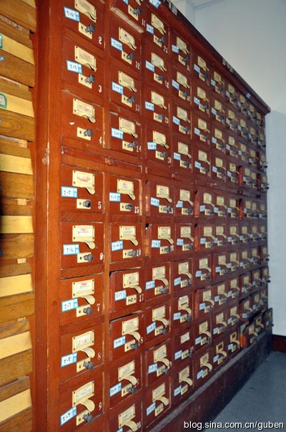
Bin（卡片箱）
Bin | 卡片箱
索引空闲块 | 索引可借的书
有时也被称为空闲链表(free list) | 读者卡片
为了加快释放和分配速度，释放时放入bin，分配时先在bin里寻找 | 提高查找书的速度
分成两大类，多种bin | “所有目录加起来至少有四大套，里面还包括著者目录、书名目录（或者著者和书名混合的排架目录）和分类目录等，卡片有7-8套”
Notes:
索引空闲块
有时也被称为空闲链表(free list)
为了加快释放和分配速度，释放时放入bin，分配时先在bin里寻找
超大块是例外
直接调用mmap和munmap

Slide 76
两类bin
fastbin
共有10个
只记录小于80字节的小块
普通bin
分成三种
以双向链表索引
单向链表
每个bin里的块大小相同
无序，小块，大块

Slide 77
Bin总览
Fast bin
Unsorted bin
Small bin
Large bin
Chunks of size less than 512 bytes
Chunks of size 16 to 80 bytes
Chunks of size greater than equal to 512 bytes
大小不确定
为了复用最近释放的块，提高性能
the freelist data structures
Notes:
Bins are the freelist datastructures. They are used to hold free chunks. Based on chunk sizes, different bins are available
When small or large chunk gets freed instead of adding them in to their respective bins, its gets added into unsorted bin. This approach gives ‘glibc malloc’ a second chance to reuse the recently freed chunks. Hence memory allocation and deallocation speeds up a bit (because of unsorted bin) since time taken to look for appropriate bin is eliminated.
Number of bins – 1
Unsorted bin contains a circular double linked list (a.k.a binlist) of free chunks.
Chunk size – There is no size restriction, chunks of any size belongs to this bin.

Slide 78
fastbin
里面的块不标记为空闲，保持busy状态
释放和分配都快
单向链表
添加和删除都在头尾端进行，先进先出
按8字节单位划分
bin 0存放的都是16字节的块（用户区8字节）
Bin 1… 24
Bin 2… (2+2)*8 = 32
Bin 9… (9+2)*8 = 88 (用户区80字节)
/* The maximum fastbin request size we support */
#define MAX_FAST_SIZE 80
#define NFASTBINS (fastbin_index(request2size(MAX_FAST_SIZE))+1)

Slide 79
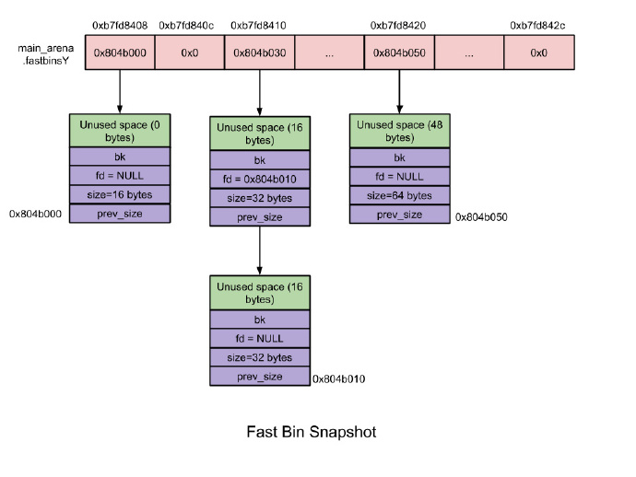
Fastbin快照

Slide 80
从fastbin中分配堆块
/*
If the size qualifies as a fastbin, first check corresponding bin.
This code is safe to execute even if av is not yet initialized, so we
can try it without checking, which saves some time on this fast path.
*/
if ((unsigned long)(nb) <= (unsigned long)(av->max_fast)) {
fb = &(av->fastbins[(fastbin_index(nb))]); //把fb指向对应的bin（卡片箱）
if ( (victim = *fb) != 0) { //把箱子里的内容给victim，如果不为空说明有内容
*fb = victim->fd; //把箱子里的内容更新为下一个
check_remalloced_chunk(av, victim, nb);
return chunk2mem(victim);
}
}
#define fastbin(ar_ptr, idx) ((ar_ptr)->fastbinsY[idx])
/* offset 2 to use otherwise unindexable first 2 bins */
#define fastbin_index(sz) \
((((unsigned int)(sz)) >> (SIZE_SZ == 8 ? 4 : 3)) - 2)

Slide 81
Fastbin的块上限是可配置的
/*
M_MXFAST is the maximum request size used for "fastbins", special bins that hold returned chunks without consolidating their spaces. This enables future requests for chunks of the same size to be handled very quickly, but can increase fragmentation, and thus increase the overall memory footprint of a program.
This malloc manages fastbins very conservatively yet still efficiently, so fragmentation is rarely a problem for values less than or equal to the default. The maximum supported value of MXFAST is 80. You wouldn't want it any higher than this anyway. Fastbins are designed especially for use with many small structs, objects or strings -- the default handles structs/objects/arrays with sizes up
to 8 4byte fields, or small strings representing words, tokens, etc. Using fastbins for larger objects normally worsens fragmentation without improving speed.
M_MXFAST is set in REQUEST size units. It is internally used in chunksize units, which adds padding and alignment. You can reduce M_MXFAST to 0 to disable all use of fastbins. This causes the malloc algorithm to be a closer approximation of fifo-best-fit in all cases, not just for larger requests, but will generally cause it to be slower.
*/
Notes:
Fastbin可能导致堆碎片化

Slide 82
av->max_fast为什么是72而不是88？
(gdb) p av->max_fast
$46 = 72
#ifndef DEFAULT_MXFAST
#define DEFAULT_MXFAST 64
#endif
(gdb) p global_max_fast
$8 = 64

Slide 83
格物
#0 _int_malloc (av=0x80521a0, bytes=8) at malloc.c:3851
#1 0x0804cf49 in malloc (bytes=8) at malloc.c:3350
#2 0xb7269474 in ?? () from /usr/lib/i386-linux-gnu/libxcb.so.1
#3 0xb72697db in ?? () from /usr/lib/i386-linux-gnu/libxcb.so.1
#4 0xb76a1a8a in ?? () from /usr/lib/i386-linux-gnu/libX11.so.6
#5 0xb76a1b8f in ?? () from /usr/lib/i386-linux-gnu/libX11.so.6
#6 0xb76a239f in _XEventsQueued () from /usr/lib/i386-linux-gnu/libX11.so.6
#7 0xb7693138 in XPending () from /usr/lib/i386-linux-gnu/libX11.so.6
#8 0xb7b07f3c in ?? () from /usr/lib/i386-linux-gnu/libgdk-x11-2.0.so.0
#9 0xb79adb3b in g_main_context_check () from /lib/i386-linux-gnu/libglib-2.0.so.0
#10 0xb79ae002 in ?? () from /lib/i386-linux-gnu/libglib-2.0.so.0
#11 0xb79ae52b in g_main_loop_run () from /lib/i386-linux-gnu/libglib-2.0.so.0
#12 0xb7c96bff in gtk_main () from /usr/lib/i386-linux-gnu/libgtk-x11-2.0.so.0
#13 0x0804a650 in main (argc=1, argv=0xbffff404) at gemalloc.c:301

Slide 84
(gdb) p nb
$55 = 16
(gdb) p fb
$56 = (mfastbinptr *) 0x80521bc
(gdb) p av->fastbins[0]
$57 = (mfastbinptr) 0x80f8f18
(gdb) p &av->fastbins[0]
$58 = (mfastbinptr *) 0x80521bc
(gdb) p *av->fastbins[0]
$59 = {prev_size = 1145324612, size = 17, fd = 0x80ce370, bk = 0x80f4f30}
(gdb) p *fb
$60 = (mfastbinptr) 0x80f8f18
(gdb) x /xw 0x80521bc
0x80521bc <main_arena+28>: 0x080f8f18
(gdb) p /t 17
$61 = 10001
(gdb) p victim
$62 = (mchunkptr) 0x80f8f18
(gdb) l
3848 if ((unsigned long)(nb) <= (unsigned long)(av->max_fast)) {
3849 fb = &(av->fastbins[(fastbin_index(nb))]);
3850 if ( (victim = *fb) != 0) {
3851 *fb = victim->fd;
3852 check_remalloced_chunk(av, victim, nb);
3853 return chunk2mem(victim);
3854 }
3855 }
块总大小
把fb指向bin
Bin中目前的块
总大小为16字节，注意，第三位是标志
将要更新卡片箱

Slide 85
(gdb) p nb
$70 = 40
(gdb) macro expand fastbin_index(40)
expands to: ((((unsigned int)(40)) >> 3) - 2)
(gdb) p ((((unsigned int)(40)) >> 3) - 2)
$71 = 3
(gdb) p &av->fastbins[3]
$72 = (mfastbinptr *) 0x80521c8
(gdb) p fb
$73 = (mfastbinptr *) 0x80521c8
(gdb) p av->fastbins[3]
$74 = (mfastbinptr) 0x80f12d8
(gdb) p *fb
$75 = (mfastbinptr) 0x80f12d8
(gdb) p victim
$76 = (mchunkptr) 0x80f12d8
(gdb) p *victim
$77 = {prev_size = 0, size = 41, fd = 0x80cdb60, bk = 0x0}
(gdb) l
3848 if ((unsigned long)(nb) <= (unsigned long)(av->max_fast)) {
3849 fb = &(av->fastbins[(fastbin_index(nb))]);
3850 if ( (victim = *fb) != 0) {
3851 *fb = victim->fd;
3852 check_remalloced_chunk(av, victim, nb);
3853 return chunk2mem(victim);
3854 }
3855 }
#0 _int_malloc (av=0x80521a0, bytes=36) at malloc.c:3851
#1 0x0804cf49 in malloc (bytes=36) at malloc.c:3350
#2 0xb7269394 in ?? () from /usr/lib/i386-linux-gnu/libxcb.so.1
(gdb) n
3853 return chunk2mem(victim);
(gdb) p av->fastbins[3]
$79 = (mfastbinptr) 0x80cdb60
单步一行后，更新了bin里的内容

Slide 86
常规bin
(gdb) pt main_arena
type = struct malloc_state {
mutex_t mutex;
long int stat_lock_direct;
long int stat_lock_loop;
long int stat_lock_wait;
long int pad0_[1];
size_t max_fast;
mfastbinptr fastbins[10];
mchunkptr top;
mchunkptr last_remainder;
mchunkptr bins[256];
unsigned int binmap[4];
struct malloc_state *next;
size_t system_mem;
size_t max_system_mem;
}
共128个
双向链表管理，每两个元素对应一个bin
Bin 1 – Unsorted bin
Bin 2 to Bin 63 – Small bin
Bin 64 to Bin 126 – Large bin
#define NBINS 128
#define NSMALLBINS 64

Slide 87
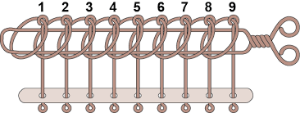
普通bin（regular bin）
双向链表
以数组形式定义，256元素，每个元素是malloc_chunk *
两个数组元素组成一个bin，与其它空闲块的fd和bk指针手拉手串起来
(gdb) ptype main_arena.bins[1]
type = struct malloc_chunk {
size_t prev_size;
size_t size;
struct malloc_chunk *fd;
struct malloc_chunk *bk;
} *
(gdb) p sizeof(main_arena.bins[1])
$8 = 4
(gdb) p sizeof(main_arena.bins)
$9 = 1024

Slide 88
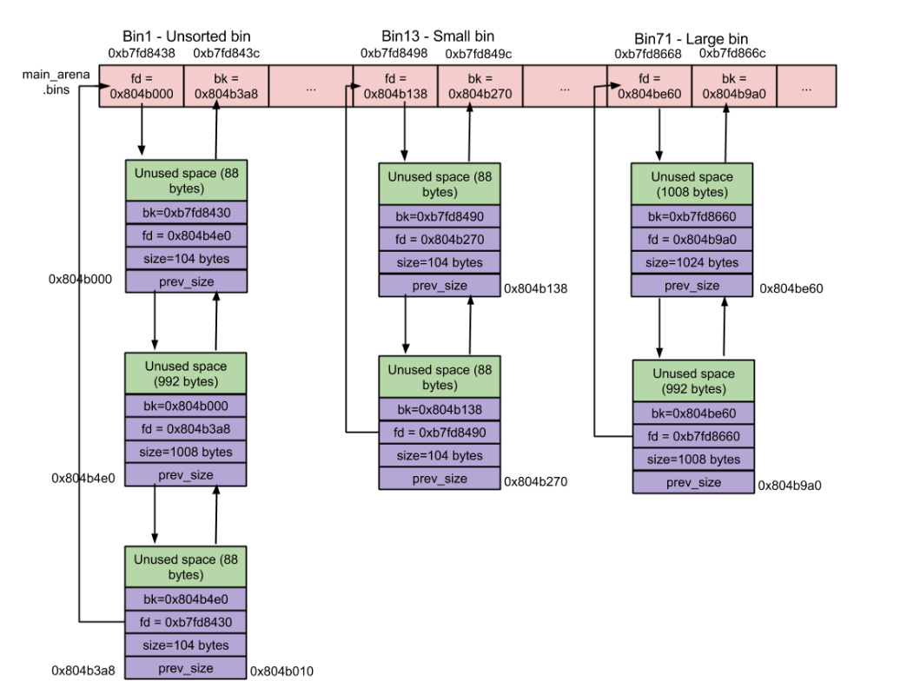
https://sploitfun.wordpress.com/2015/02/10/understanding-glibc-malloc/

Slide 89
从小箱分配
if (in_smallbin_range(nb)) {
idx = smallbin_index(nb);
bin = bin_at(av,idx);
if ( (victim = last(bin)) != bin) {
if (victim == 0) /* initialization check */
malloc_consolidate(av);
else {
bck = victim->bk;
set_inuse_bit_at_offset(victim, nb);
bin->bk = bck;
bck->fd = bin;
if (av != &main_arena)
victim->size |= NON_MAIN_ARENA;
check_malloced_chunk(av, victim, nb);
return chunk2mem(victim);
}
}
}
/*
If a small request, check regular bin. Since these "smallbins"
hold one size each, no searching within bins is necessary.
(For a large request, we need to wait until unsorted chunks are
processed to find best fit. But for small ones, fits are exact
anyway, so we can check now, which is faster.)
*/

Slide 90
格物
#0 _int_malloc (av=0x80521a0, bytes=36) at malloc.c:3918
#1 0x0804cf49 in malloc (bytes=36) at malloc.c:3350
#2 0xb7269394 in ?? () from /usr/lib/i386-linux-gnu/libxcb.so.1
#3 0xb72697db in ?? () from /usr/lib/i386-linux-gnu/libxcb.so.1
(gdb) p nb
$80 = 40
(gdb) p idx
$81 = 5
(gdb) p av->bins[10]
$85 = (mchunkptr) 0x805220c
(gdb) p av->bins[11]
$86 = (mchunkptr) 0x805220c
请求36字节，fastbin不能满足请求，则尝试smallbin，计算出是5号箱，但是为空，于是会尝试无序bin
#define SMALLBIN_WIDTH 8
#define MIN_LARGE_SIZE 512
#define in_smallbin_range(sz) \
((unsigned long)(sz) < (unsigned long)MIN_LARGE_SIZE)
#define smallbin_index(sz) (((unsigned)(sz)) >> 3)

Slide 91
小块分配过程
计算分配大小
checked_request2size
如果小于global_max_fast
计算fastbin_index
遍历对应fastbin
尝试small bin
分配成功则返回
尝试最近释放的块(无序bin)
计算smallbin_index
在对应的bin中找空闲块
成功则返回
尝试上次分割剩下的块last_remainder
分割top块

Slide 92
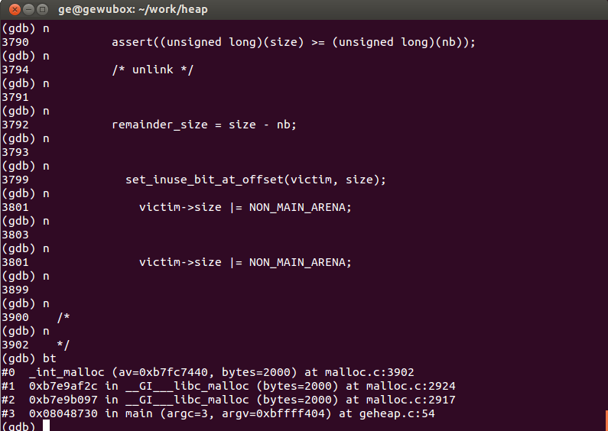
跟踪malloc
(gdb) bt
#0 _int_malloc (av=0xb7fc7440, bytes=2000) at malloc.c:3902
#1 0xb7e9af2c in __GI___libc_malloc (bytes=2000) at malloc.c:2924
#2 0xb7e9b097 in __GI___libc_malloc (bytes=2000) at malloc.c:2917
#3 0x08048730 in main (argc=3, argv=0xbffff404) at geheap.c:54
Notes:
Directory /home/ge/eglibc-2.15/malloc
普通libc编译时已经开启优化，所以：
复制ptmalloc2
Make “linux-pthread”
Gcc test.c libmalloc.a –g3 –o test …
顺序重要，要放在前面

Slide 93
============== After allocating blocks ==============
Total non-mmapped bytes (arena): 135168
# of free chunks (ordblks): 1
# of free fastbin blocks (smblks): 0
# of mapped regions (hblks): 0
Bytes in mapped regions (hblkhd): 0
Max. total allocated space (usmblks): 0
Free bytes held in fastbins (fsmblks): 0
Total allocated space (uordblks): 2016
Total free space (fordblks): 133152
Topmost releasable block (keepcost): 133152
============== After freeing blocks ==============
Total non-mmapped bytes (arena): 135168
# of free chunks (ordblks): 1
# of free fastbin blocks (smblks): 0
# of mapped regions (hblks): 0
Bytes in mapped regions (hblkhd): 0
Max. total allocated space (usmblks): 0
Free bytes held in fastbins (fsmblks): 0
Total allocated space (uordblks): 0
Total free space (fordblks): 135168
Topmost releasable block (keepcost): 135168
调用malloc(1000)两次，块头占8字节
通过mallinfo接口获取信息
https://www.systutorials.com/docs/linux/man/3-mallinfo/

Slide 94
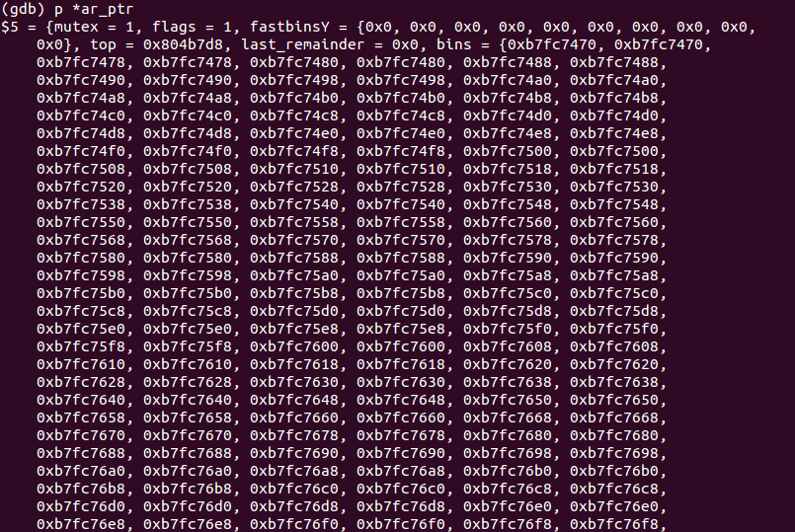
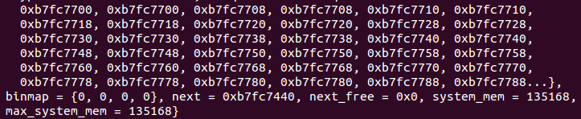

Slide 95
free

Slide 96

看人下菜碟儿
小于max_fast
放入fastbin
超大块
直接还给内核
大客户是偶尔的，不要搞不清自己的身份
介于中间的
标记为free
放入无序bin
快速释放
嫌弃态度：就这么一点点空间，值得我弄一会么？
顺便合并空闲块
如果临近top，则更新top
根据需要修剪
Notes:
http://www.sohu.com/a/153373338_570249
当然，到处都是“看人下菜碟儿”的：天皇皇后两位陛下和皇太子曾经在同年同月访问岩手县北上市。当天皇皇后二位陛下“巡幸”的时候，岩手县知事和市长、市议会议员围绕着一览圣颜，此外，大量的市民也围绕在市政府门前，热烈地表示欢迎。皇太子到访的时候，出来欢迎他的只有北上市的副市长，以及80多名2年级的小学生在市政府门前列队欢迎。真让人哭笑不得——皇太子是未来的天皇啊……

Slide 97
#0 free (mem=0x80f3d48) at malloc.c:3385
#1 0xb72682dd in ?? () from /usr/lib/i386-linux-gnu/libxcb.so.1
#2 0xb72697e6 in ?? () from /usr/lib/i386-linux-gnu/libxcb.so.1
#3 0xb76a1a8a in ?? () from /usr/lib/i386-linux-gnu/libX11.so.6
#4 0xb76a1b8f in ?? () from /usr/lib/i386-linux-gnu/libX11.so.6
…
#8 0xb79adb3b in g_main_context_check () from /lib/i386-linux-gnu/libglib-2.0.so.0
#9 0xb79ae002 in ?? () from /lib/i386-linux-gnu/libglib-2.0.so.0
#10 0xb79ae52b in g_main_loop_run () from /lib/i386-linux-gnu/libglib-2.0.so.0
#11 0xb7c96bff in gtk_main () from /usr/lib/i386-linux-gnu/libgtk-x11-2.0.so.0
#12 0x0804a650 in main (argc=1, argv=0xbffff404) at gemalloc.c:301
(gdb) n
3387 if (hook != NULL) {
(gdb)
3392 if (mem == 0) /* free(0) has no effect */
(gdb)
3395 p = mem2chunk(mem);
(gdb)
3398 if (chunk_is_mmapped(p)) /* release mmapped memory. */
(gdb) p p
$90 = (mchunkptr) 0x80f3d40
(gdb) p *p
$91 = {prev_size = 55, size = 17, fd = 0x80f33c8, bk = 0x80ce818}

Slide 98
续
(gdb) n
3405 ar_ptr = arena_for_chunk(p);
(gdb) s
3407 if(!mutex_trylock(&ar_ptr->mutex))
(gdb) macro expand arena_for_chunk(p)
expands to: (((p)->size & 0x4) ? ((heap_info *)((unsigned long)(p) & ~((1024*1024)-1)))->ar_ptr : &main_arena)
(gdb) n
3408 ++(ar_ptr->stat_lock_direct);
(gdb)
3416 _int_free(ar_ptr, mem);

Slide 99
_int_free – 释放到fastbin
(gdb) s
_int_free (av=0x80521a0, mem=0x80f3d48) at malloc.c:4206
4206 if (mem != 0) {
(gdb) n
4207 p = mem2chunk(mem);
(gdb)
4208 size = chunksize(p);
(gdb)
4217 if ((unsigned long)(size) <= (unsigned long)(av->max_fast)
(gdb)
4228 set_fastchunks(av);
(gdb)
4229 fb = &(av->fastbins[fastbin_index(size)]);
(gdb)
4230 p->fd = *fb;
(gdb)
4231 *fb = p;
(gdb)
4347 }
链表更新好就OK了，不必设置为空闲块

Slide 100
set_fastchunks
Max_fast的最低两位是标志位
(gdb) macro expand set_fastchunks(av)
expands to: ((av)->max_fast &= ~(1U))
(gdb) p av->max_fast
$95 = 72
(gdb) n
4228 set_fastchunks(av);
(gdb)
4229 fb = &(av->fastbins[fastbin_index(size)]);
(gdb) p av->max_fast
$96 = 72

Slide 101
直接返还超大块
/*
If the chunk was allocated via mmap, release via munmap(). Note
that if HAVE_MMAP is false but chunk_is_mmapped is true, then
user must have overwritten memory. There's nothing we can do to
catch this error unless MALLOC_DEBUG is set, in which case
check_inuse_chunk (above) will have triggered error.
*/
else {
#if HAVE_MMAP
int ret;
INTERNAL_SIZE_T offset = p->prev_size;
mp_.n_mmaps--;
mp_.mmapped_mem -= (size + offset);
ret = munmap((char*)p - offset, size + offset);
/* munmap returns non-zero on failure */
assert(ret == 0);
#endif
}

Slide 102
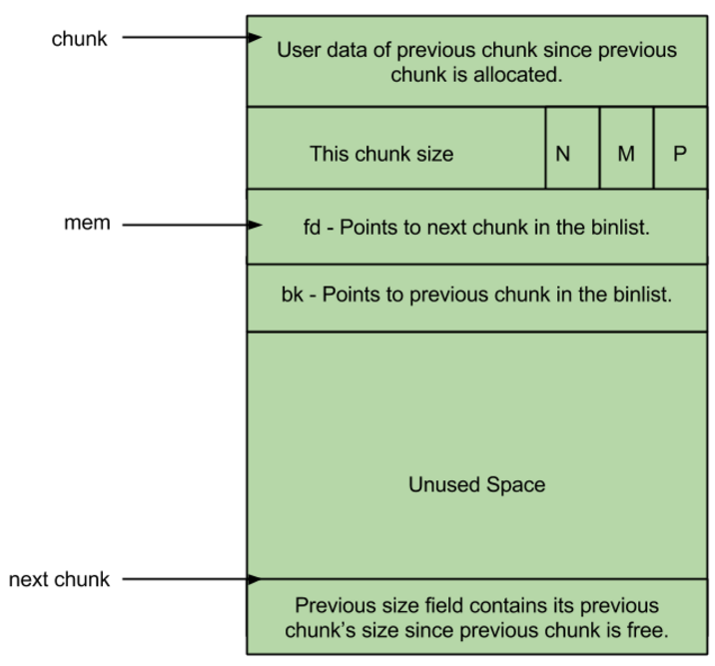
Free Chunk
prev_size: No two free chunks can be adjacent together. When both the chunks are free, its gets combined into one single free chunk. Hence always previous chunk to this freed chunk would be allocated and therefore prev_size contains previous chunk’s user data.
size: This field contains the size of this free chunk.
fd: Forward pointer – Points to next chunk in the same bin (and NOT to the next chunk present in physical memory).
bk: Backward pointer – Points to previous chunk in the same bin (and NOT to the previous chunk present in physical memory).

Slide 103
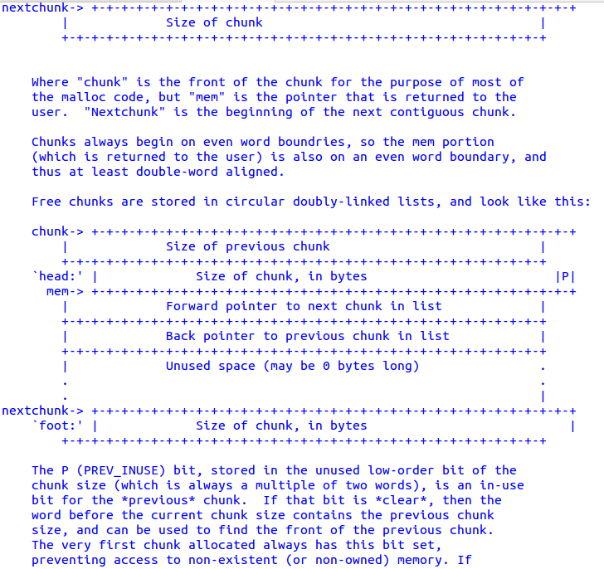
malloc.c

Slide 104
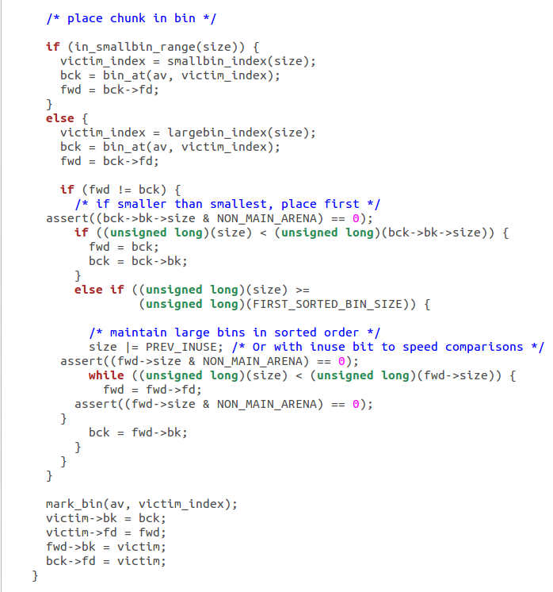
何时放入常规bin？
/*
Place the chunk in unsorted chunk list. Chunks are not placed into regular bins until after they have been given one chance to be used in malloc. */
释放时先放到无序bin
下次执行malloc时，放入所属的常规bin

Slide 105
0804c000-0806d000 rw-p 00000000 00:00 0 [heap]
0806d000-08090000 rw-p 00000000 00:00 0 [heap]
08090000-080b2000 rw-p 00000000 00:00 0 [heap]
#0 __GI___sbrk (increment=-4096) at sbrk.c:35
#1 0xb79c4f4f in __GI___default_morecore (increment=-4096) at morecore.c:49
#2 0xb79beedd in sYSTRIm (pad=<optimized out>, av=<optimized out>) at malloc.c:2810
#3 0xb79bfcb5 in _int_free (av=0xb7af2440, p=0x808fff8, have_lock=1) at malloc.c:4196
0804c000-0806d000 rw-p 00000000 00:00 0 [heap]
0806d000-08090000 rw-p 00000000 00:00 0 [heap]
08090000-080b1000 rw-p 00000000 00:00 0 [heap]

Slide 106
概览
批发
分配和释放
Arena
Valgrind

Slide 107
Mapped: 93660 kB
Shmem: 15068 kB
Slab: 44596 kB
SReclaimable: 32576 kB
SUnreclaim: 12020 kB
KernelStack: 3008 kB
PageTables: 7428 kB
NFS_Unstable: 0 kB
Bounce: 0 kB
WritebackTmp: 0 kB
CommitLimit: 1166460 kB
Committed_AS: 2400960 kB
VmallocTotal: 249912 kB
VmallocUsed: 20264 kB
VmallocChunk: 221168 kB
HardwareCorrupted: 0 kB
AnonHugePages: 0 kB
HugePages_Total: 0
HugePages_Free: 0
HugePages_Rsvd: 0
HugePages_Surp: 0
Hugepagesize: 2048 kB
DirectMap4k: 34752 kB
DirectMap2M: 751616 kB
ge@gewubox:~/work/heap$ cat /proc/meminfo
MemTotal: 766212 kB
MemFree: 90056 kB
Buffers: 12236 kB
Cached: 275296 kB
SwapCached: 348 kB
Active: 306888 kB
Inactive: 304720 kB
Active(anon): 156212 kB
Inactive(anon): 182932 kB
Active(file): 150676 kB
Inactive(file): 121788 kB
Unevictable: 0 kB
Mlocked: 0 kB
HighTotal: 0 kB
HighFree: 0 kB
LowTotal: 766212 kB
LowFree: 90056 kB
SwapTotal: 783356 kB
SwapFree: 778140 kB
Dirty: 28 kB
Writeback: 0 kB
AnonPages: 323768 kB

Slide 108
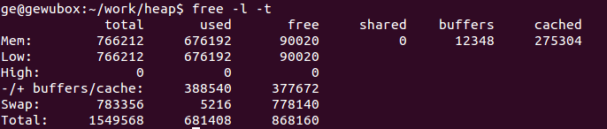
free

Slide 109
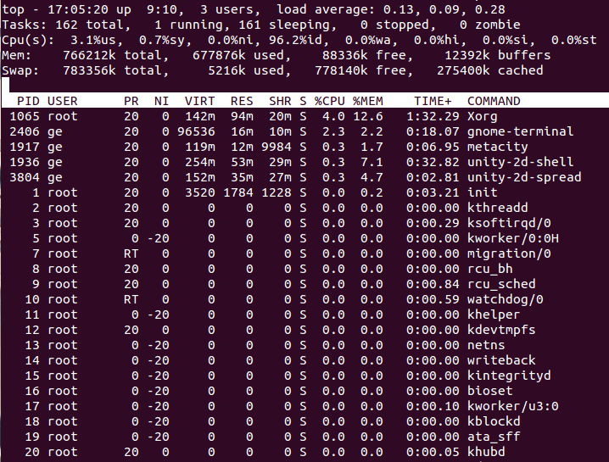
top

Slide 110
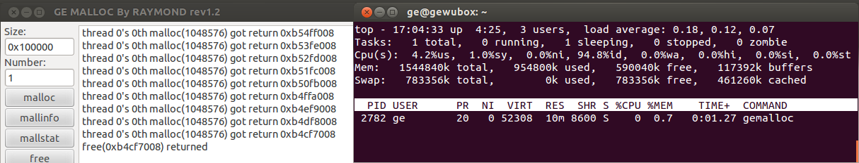
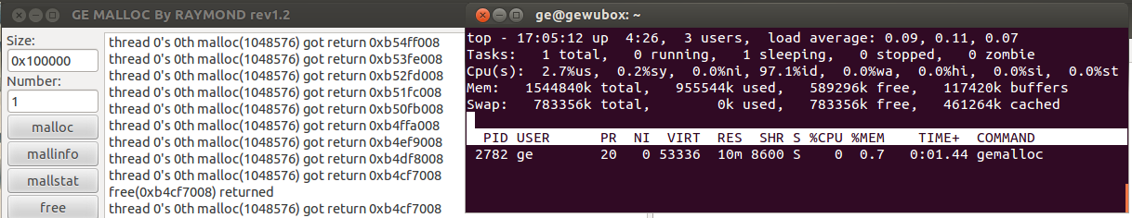
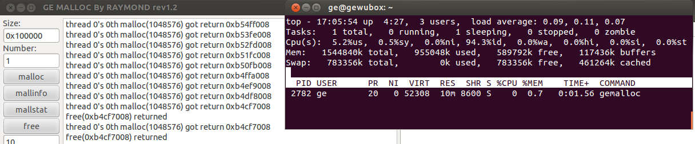
分配前
分配1MB后
释放后

Slide 111

堆陷阱
多次释放
使用释放后的块
释放野指针
溢出
刀刀致命
Notes:
Failure to handle failed memory allocation
Needed for every allocation
Allocate too much memory
No built-in limit on memory usage

Slide 112



Slide 113
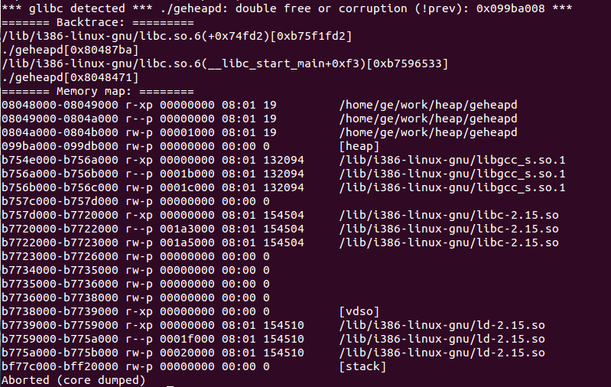
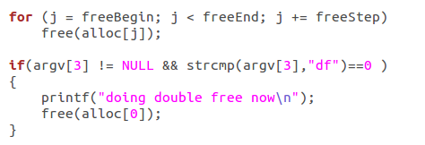
Double Free
Notes:
if(argv[3] != NULL && strcmp(argv[3],"df")==0 )
{
printf("doing double free now\n");
free(alloc[0]);
}

Slide 114
第二次释放80字节的块
Program received signal SIGSEGV, Segmentation fault.
0x0804dc8e in _int_malloc (av=0x80521a0, bytes=46) at malloc.c:3876
warning: Source file is more recent than executable.
3876 bck->fd = bin;
(gdb) bt
#0 0x0804dc8e in _int_malloc (av=0x80521a0, bytes=46) at malloc.c:3876
#1 0x0804d734 in calloc (n=1, elem_size=46) at malloc.c:3633
#2 0xb79b3753 in ?? () from /lib/i386-linux-gnu/libglib-2.0.so.0
#3 0xb79b3e6b in g_malloc0 () from /lib/i386-linux-gnu/libglib-2.0.so.0
#4 0xb73a7cae in ?? () from /usr/lib/i386-linux-gnu/libpango-1.0.so.0
…
#15 0x0804987a in append_list (szMsg=0xbfffe17c) at gemalloc.c:27
#16 0x080498e0 in d4d (format=0x804faa2 "free(%p) returned") at gemalloc.c:40
#17 0x08049a94 in button_free_clicked (data=0x0) at gemalloc.c:101
释放返回后
再分配时非法访问

Slide 115
二次释放8字节的块
#0 0x0804e749 in malloc_consolidate (av=0xb6000010) at malloc.c:4415
#1 0x0804dd48 in _int_malloc (av=0xb6000010, bytes=513) at malloc.c:3900
#2 0x0804ea68 in _int_realloc (av=0xb6000010, oldmem=0xb60102b8, bytes=512) at malloc.c:4541
#3 0x0804d2b2 in realloc (oldmem=0xb60102b8, bytes=512) at malloc.c:3489
…
#20 0xb7a8a2cc in g_signal_emit_valist () from /usr/lib/i386-linux-gnu/libgobject-2.0.so.0
#21 0xb7e3dcaa in gtk_signal_emit_by_name () from /usr/lib/i386-linux-gnu/libgtk-x11-2.0.so.0
#22 0xb7e082d9 in ?? () from /usr/lib/i386-linux-gnu/libgtk-x11-2.0.so.0
#23 0xb7e13e71 in ?? () from /usr/lib/i386-linux-gnu/libgtk-x11-2.0.so.0
#24 0xb7e0efa0 in gtk_clist_append () from /usr/lib/i386-linux-gnu/libgtk-x11-2.0.so.0
#25 0x0804987a in append_list (szMsg=0xbfffe17c) at gemalloc.c:27
#26 0x080498e0 in d4d (format=0x804faa2 "free(%p) returned") at gemalloc.c:40
#27 0x08049a94 in button_free_clicked (data=0x0) at gemalloc.c:101
释放返回
再分配时合并块时死循环

Slide 116
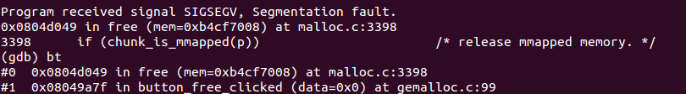
Double free超大块

Slide 117
/*
Debugging:
Because freed chunks may be overwritten with bookkeeping fields, this
malloc will often die when freed memory is overwritten by user
programs. This can be very effective (albeit in an annoying way)
in helping track down dangling pointers.
If you compile with -DMALLOC_DEBUG, a number of assertion checks are
enabled that will catch more memory errors. You probably won't be
able to make much sense of the actual assertion errors, but they
should help you locate incorrectly overwritten memory. The checking
is fairly extensive, and will slow down execution
noticeably. Calling malloc_stats or mallinfo with MALLOC_DEBUG set
will attempt to check every non-mmapped allocated and free chunk in
the course of computing the summmaries. (By nature, mmapped regions
cannot be checked very much automatically.)
Setting MALLOC_DEBUG may also be helpful if you are trying to modify
this code. The assertions in the check routines spell out in more
detail the assumptions and invariants underlying the algorithms.
Setting MALLOC_DEBUG does NOT provide an automated mechanism for
checking that all accesses to malloced memory stay within their
bounds. However, there are several add-ons and adaptations of this
or other mallocs available that do this.
*/
Notes:
From malloc.c

Slide 118
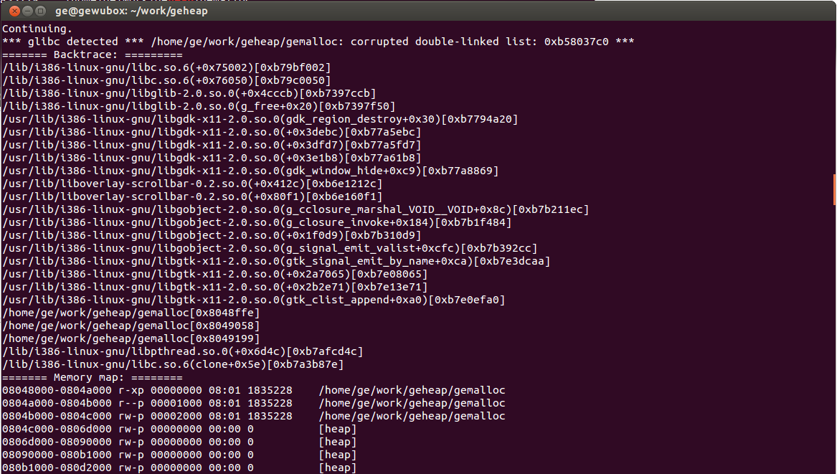

Slide 119

Valgrind
an instrumentation framework for building dynamic analysis tools
There are Valgrind tools that can automatically detect many memory management and threading bugs, and profile your programs in detail
You can also use Valgrind to build new tools
安装：sudo apt-get install valgrind
Notes:
Valgrind is an instrumentation framework for building dynamic analysis tools. There are Valgrind tools that can automatically detect many memory management and threading bugs, and profile your programs in detail. You can also use Valgrind to build new tools.
The Valgrind distribution currently includes six production-quality tools: a memory error detector, two thread error detectors, a cache and branch-prediction profiler, a call-graph generating cache and branch-prediction profiler, and a heap profiler. It also includes three experimental tools: a stack/global array overrun detector, a second heap profiler that examines how heap blocks are used, and a SimPoint basic block vector generator. It runs on the following platforms: X86/Linux, AMD64/Linux, ARM/Linux, ARM64/Linux, PPC32/Linux, PPC64/Linux, PPC64LE/Linux, S390X/Linux, MIPS32/Linux, MIPS64/Linux, TILEGX/Linux, X86/Solaris, AMD64/Solaris, ARM/Android (2.3.x and later), ARM64/Android, X86/Android (4.0 and later), MIPS32/Android, X86/Darwin and AMD64/Darwin (Mac OS X 10.10, with initial support for 10.11).
Valgrind is Open Source / Free Software, and is freely available under the GNU General Public License, version 2.

Slide 120
基本原理
A program running under Valgrind is not executed directly by the CPU. Instead it runs on a synthetic CPU provided by Valgrind.
Your program is then run on a synthetic CPU provided by the Valgrind core. As new code is executed for the first time, the core hands the code to the selected tool. The tool adds its own instrumentation code to this and hands the result back to the core, which coordinates the continued execution of this instrumented code.
This is why a debugger cannot debug your program when it runs on Valgrind.

Slide 121
包一层
int foo ( int x, int y ) { return x + y; }
#include <stdio.h>
#include "valgrind.h"
int I_WRAP_SONAME_FNNAME_ZU(NONE,foo)( int x, int y )
{
int result;
OrigFn fn;
VALGRIND_GET_ORIG_FN(fn);
printf("foo's wrapper: args %d %d\n", x, y);
CALL_FN_W_WW(result, fn, x,y);
printf("foo's wrapper: result %d\n", result);
return result;
}
http://valgrind.org/docs/manual/manual-core-adv.html#manual-core-adv.wrapping

Slide 122
兼容gdb
valgrind --vgdb=yes --vgdb-error=0 prog
gdb prog
(gdb) target remote | vgdb

Slide 123
六大工具
a memory error detector
two thread error detectors
a cache and branch-prediction profiler
a call-graph generating cache and branch-prediction profiler,
a heap profiler
Valgrind Core
Notes:
The Valgrind distribution currently includes six production-quality tools: a memory error detector, two thread error detectors, a cache and branch-prediction profiler, a call-graph generating cache and branch-prediction profiler, and a heap profiler. It also includes three experimental tools: a stack/global array overrun detector, a second heap profiler that examines how heap blocks are used, and a SimPoint basic block vector generator.

Slide 124
Memcheck: a memory error detector
Accessing memory you shouldn’t, e.g. overrunning and underrunning heap blocks, overrunning the top of the stack, and accessing memory after it has been freed.
Using undefined values, i.e. values that have not been initialised, or that have been derived from other undefined values.
Incorrect freeing of heap memory, such as double-freeing heap blocks, or mismatched use of malloc/new/new[] versus free/delete/delete[]
Overlapping src and dst pointers in memcpy and related functions.
Passing a fishy (presumably negative) value to the size parameter of a memory allocation function.
Memory leaks.

Slide 125
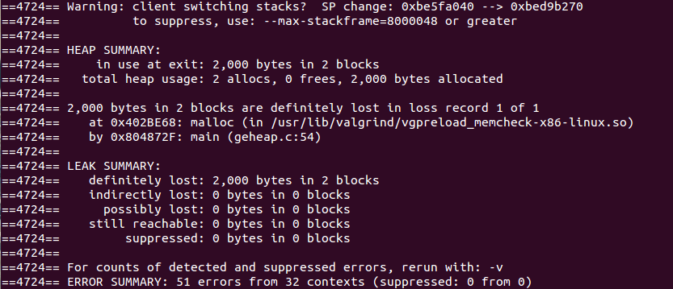
检测泄露
valgrind --tool=memcheck --leak-check=yes ./geheapd 2 1000 leak

Slide 126
泄露报告
==3145== 720 bytes in 9 blocks are definitely lost in loss record 2,943 of 3,217
==3145== at 0x402BE68: malloc (in /usr/lib/valgrind/vgpreload_memcheck-x86-linux.so)
==3145== by 0x8049343: do_malloc (gemalloc.c:57)
==3145== by 0x8049434: button_malloc_clicked (gemalloc.c:78)
==3145== by 0x456C242: g_cclosure_marshal_VOID__VOIDv (in /usr/lib/i386-linux-gnu/libgobject-2.0.so.0.3200.4)
==3145== by 0x456A726: ??? (in /usr/lib/i386-linux-gnu/libgobject-2.0.so.0.3200.4)
==3145== by 0x4583A18: g_signal_emit_valist (in /usr/lib/i386-linux-gnu/libgobject-2.0.so.0.3200.4)
==3145== by 0x4584442: g_signal_emit (in /usr/lib/i386-linux-gnu/libgobject-2.0.so.0.3200.4)
==3145== by 0x40BF289: gtk_button_clicked (in /usr/lib/i386-linux-gnu/libgtk-x11-2.0.so.0.2400.10)
==3145== by 0x40C069F: ??? (in /usr/lib/i386-linux-gnu/libgtk-x11-2.0.so.0.2400.10)
==3145== by 0x456C1EB: g_cclosure_marshal_VOID__VOID (in /usr/lib/i386-linux-gnu/libgobject-2.0.so.0.3200.4)
==3145== by 0x45692FC: ??? (in /usr/lib/i386-linux-gnu/libgobject-2.0.so.0.3200.4)
Notes:
valgrind --tool=memcheck --leak-check=full ./gemalloc > vg.txt 2>&1

Slide 127
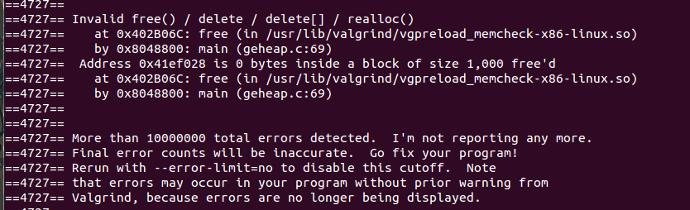
多次释放
valgrind --tool=memcheck --leak-check=yes ./geheapd 2 1000 df

Slide 128
==3164== Invalid free() / delete / delete[] / realloc()
==3164== at 0x402B06C: free (in /usr/lib/valgrind/vgpreload_memcheck-x86-linux.so)
==3164== by 0x80494AE: button_free_clicked (gemalloc.c:107)
==3164== by 0x456C242: g_cclosure_marshal_VOID__VOIDv (in /usr/lib/i386-linux-gnu/libgobject-2.0.so.0.3200.4)
==3164== by 0x456A726: ??? (in /usr/lib/i386-linux-gnu/libgobject-2.0.so.0.3200.4)
==3164== by 0x4583A18: g_signal_emit_valist (in /usr/lib/i386-linux-gnu/libgobject-2.0.so.0.3200.4)
==3164== by 0x4584442: g_signal_emit (in /usr/lib/i386-linux-gnu/libgobject-2.0.so.0.3200.4)
==3164== by 0x40BF289: gtk_button_clicked (in /usr/lib/i386-linux-gnu/libgtk-x11-2.0.so.0.2400.10)
==3164== by 0x40C069F: ??? (in /usr/lib/i386-linux-gnu/libgtk-x11-2.0.so.0.2400.10)
==3164== by 0x456C1EB: g_cclosure_marshal_VOID__VOID (in /usr/lib/i386-linux-gnu/libgobject-2.0.so.0.3200.4)
==3164== by 0x45692FC: ??? (in /usr/lib/i386-linux-gnu/libgobject-2.0.so.0.3200.4)
==3164== Address 0x6f68e00 is 0 bytes inside a block of size 80 free'd
==3164== at 0x402B06C: free (in /usr/lib/valgrind/vgpreload_memcheck-x86-linux.so)
==3164== by 0x80494AE: button_free_clicked (gemalloc.c:107)
==3164== by 0x456C242: g_cclosure_marshal_VOID__VOIDv (in /usr/lib/i386-linux-gnu/libgobject-2.0.so.0.3200.4)
==3164== by 0x456A726: ??? (in /usr/lib/i386-linux-gnu/libgobject-2.0.so.0.3200.4)
==3164== by 0x4583A18: g_signal_emit_valist (in /usr/lib/i386-linux-gnu/libgobject-2.0.so.0.3200.4)
==3164== by 0x4584442: g_signal_emit (in /usr/lib/i386-linux-gnu/libgobject-2.0.so.0.3200.4)
==3164== by 0x40BF289: gtk_button_clicked (in /usr/lib/i386-linux-gnu/libgtk-x11-2.0.so.0.2400.10)
==3164== by 0x40C069F: ??? (in /usr/lib/i386-linux-gnu/libgtk-x11-2.0.so.0.2400.10)
==3164== by 0x456C1EB: g_cclosure_marshal_VOID__VOID (in /usr/lib/i386-linux-gnu/libgobject-2.0.so.0.3200.4)
==3164== by 0x45692FC: ??? (in /usr/lib/i386-linux-gnu/libgobject-2.0.so.0.3200.4)
==3164==

Slide 129

切问而近思

